Slide 1
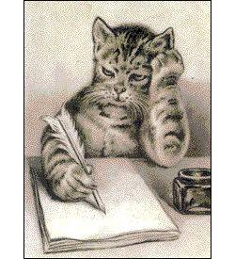
Distance Dictation
Notes:
The second activity is about dictation from a distance.
Dictation is when one person writes down what another person says.

Slide 2
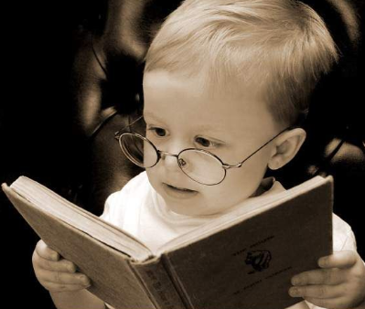
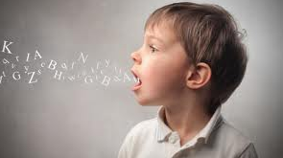
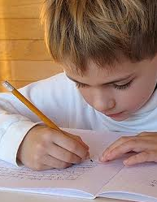
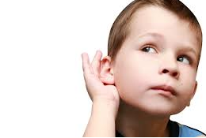
Practise four skills
speak
read
write
listen

Slide 3
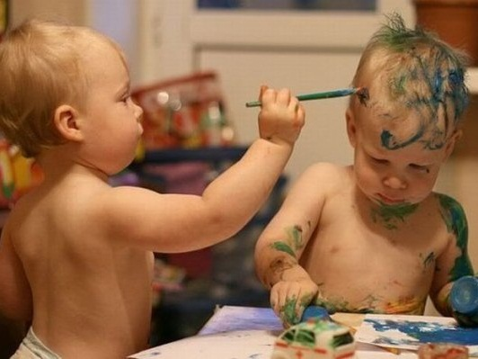
Choose a partner
Notes:
You can choose any partner.

Slide 4
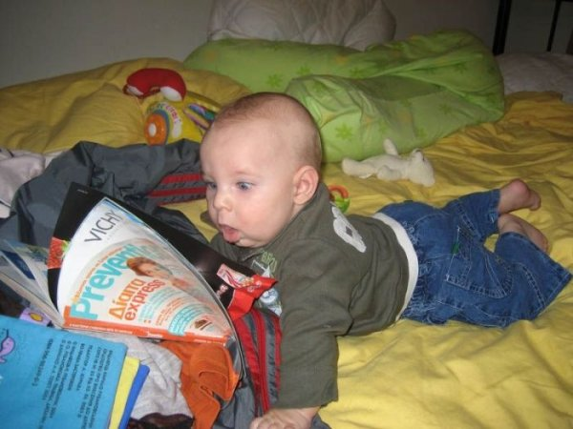
One will read and dictate …
Notes:
One of you will be reading and dictating.

Slide 5
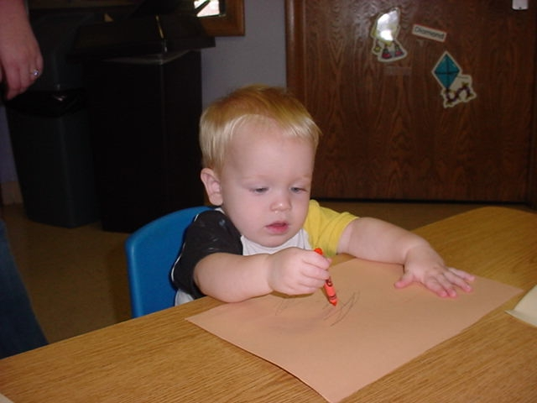
… the other will write.
Notes:
The other partner will be writing what they are told. And then you will swap jobs.

Slide 6
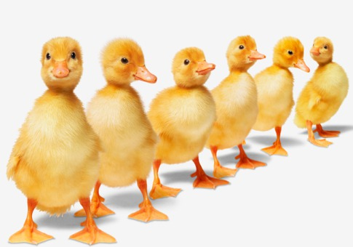
Put the texts in the right order
Notes:
There are five short passages on pages around the walls of the room. They are in random order, but there are clues in the passages about their correct order. You can collect them in any order, but then you and your partner need to arrange them in the correct order.
They also have gaps, with missing words.

Slide 7
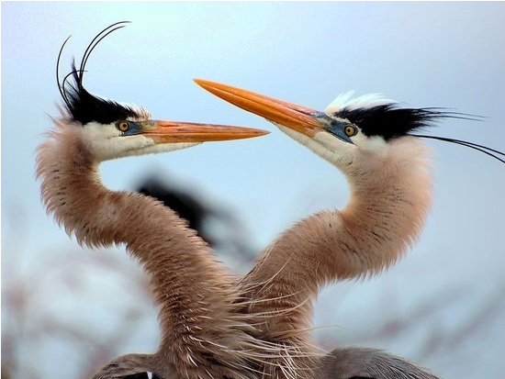
Swap jobs
Notes:
The Reader becomes the Writer, and the Writer becomes the Reader.

Slide 8
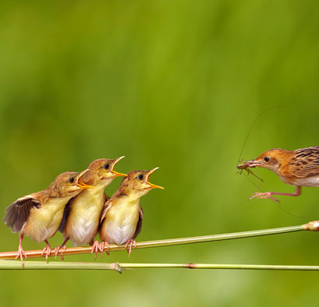
The new ‘Reader’ finds words to fill the gaps.
Notes:
Now it is the turn of the (originally) writing person to go in search of the missing words from the lists on the wall. There will be more words than the ones you need; you need to choose the best words.

Slide 9
Remember – it’s a race!
But your answers must be correct
Notes:
Accuracy is vital. But remember – this is a race, so HURRY!

