Slide 1
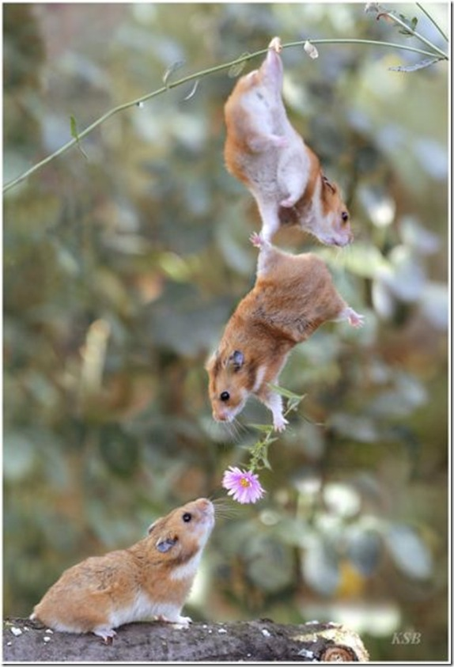
Pass it on
Sharing Language
Notes:
This session is all about getting information and passing it on accurately.

Slide 2
Two Texts
Notes:
The first activity is called ‘Two Texts’.

Slide 3
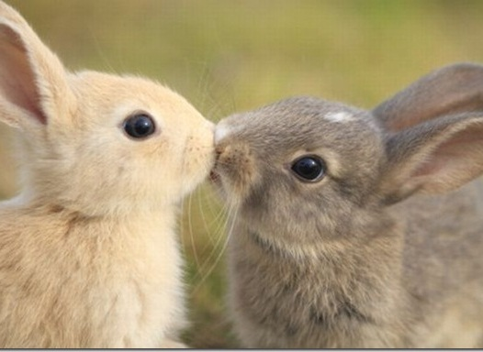
Two Groups
Group A
Group B
Notes:
Everyone will receive a card which indicates that they are in Group A or Group B. (Do not try to change groups, it will lead to confusion!)

Slide 4
Read and Remember
Notes:
Everyone will be given an article to read. Read it, and remember the facts. Do not try to memorise. Just remember the title and the facts. (Each group has a different article.)

Slide 5
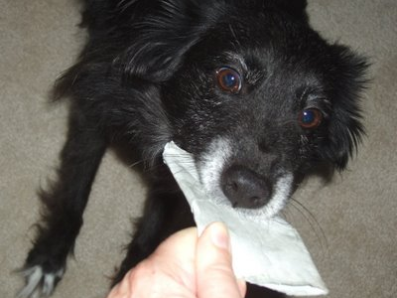
Then we’ll take the paper away
Notes:
The article papers will be collected, leaving you with just your memories.

Slide 6
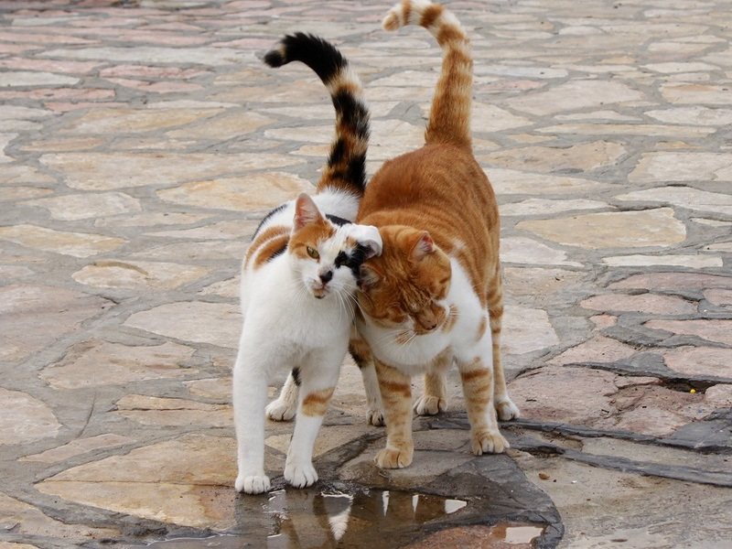
Get a partner from the OTHER group
and tell them the FACTS.
Notes:
Join with a partner from the other team. Tell them your facts, and listen to theirs. Pay close attention – you will be tested on the facts they tell you!

Slide 7
Now get a DIFFERENT partner from the OTHER group
Notes:
Now find a DIFFERENT partner from the other group.
You will each be given a list of questions relating to the article which you read. (Make sure you can remember the answers!)

Slide 8
Test your new partner.
And answer their test questions.
Notes:
Test your partner on the facts that they were told by someone else (about the same article which you read). Make a record of how many correct answers they get.
Answer their questions about the article your previous partner told you about (which they also read).

Slide 9
Let’s Play!
Notes:
Okay. Let’s play the game.

