Slide 1
The New IPG:
student centred learning
Peter Wickham
Notes:
The title of my paper is “The New IPG: student centred learning” My name is Peter Wickham; I am one of three English Language Teaching Fellows at the Institut Pendidikan Guru, Kampus Dato’ Ismail Razali here in Kuala Terengganu.
Click for slide 2

Slide 2
The New IPG:
student centred learning
A New IPG – The Winds of Change
The Winds of Change in Australia 1990 and Beyond
The “New” Australian Education 1990
Reaction to Educational Change in Australia 1990
Reaction to Educational Change in Malaysia in 2011
Notes:
We will be taking a snapshot look at the state of educational innovation in Australia, then comparing this with the situation we all see in malaysia at this moment.

Slide 3
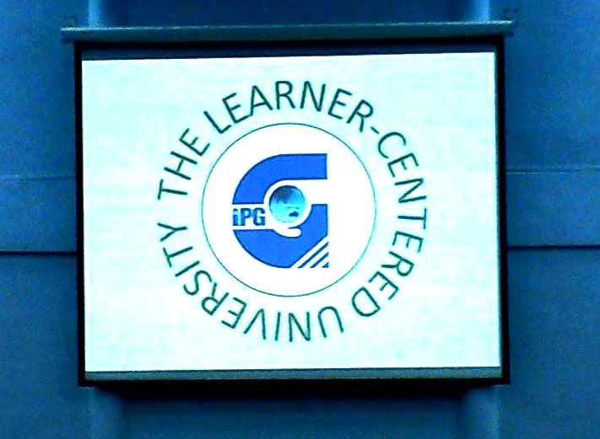
Notes:
This is what is being brought into focus: learner-centred education.
Malaysian school curriculum and teacher training curriculum are being reconsidered. Jargon such as “student centred learning”, “learner-centred university” and “educational outcomes” are being used in the context of change and reform in Malaysian education. We are seeing outsourcing of educational programs in the Tell project and the Fellows project among others.
Click for slide 4

Slide 4
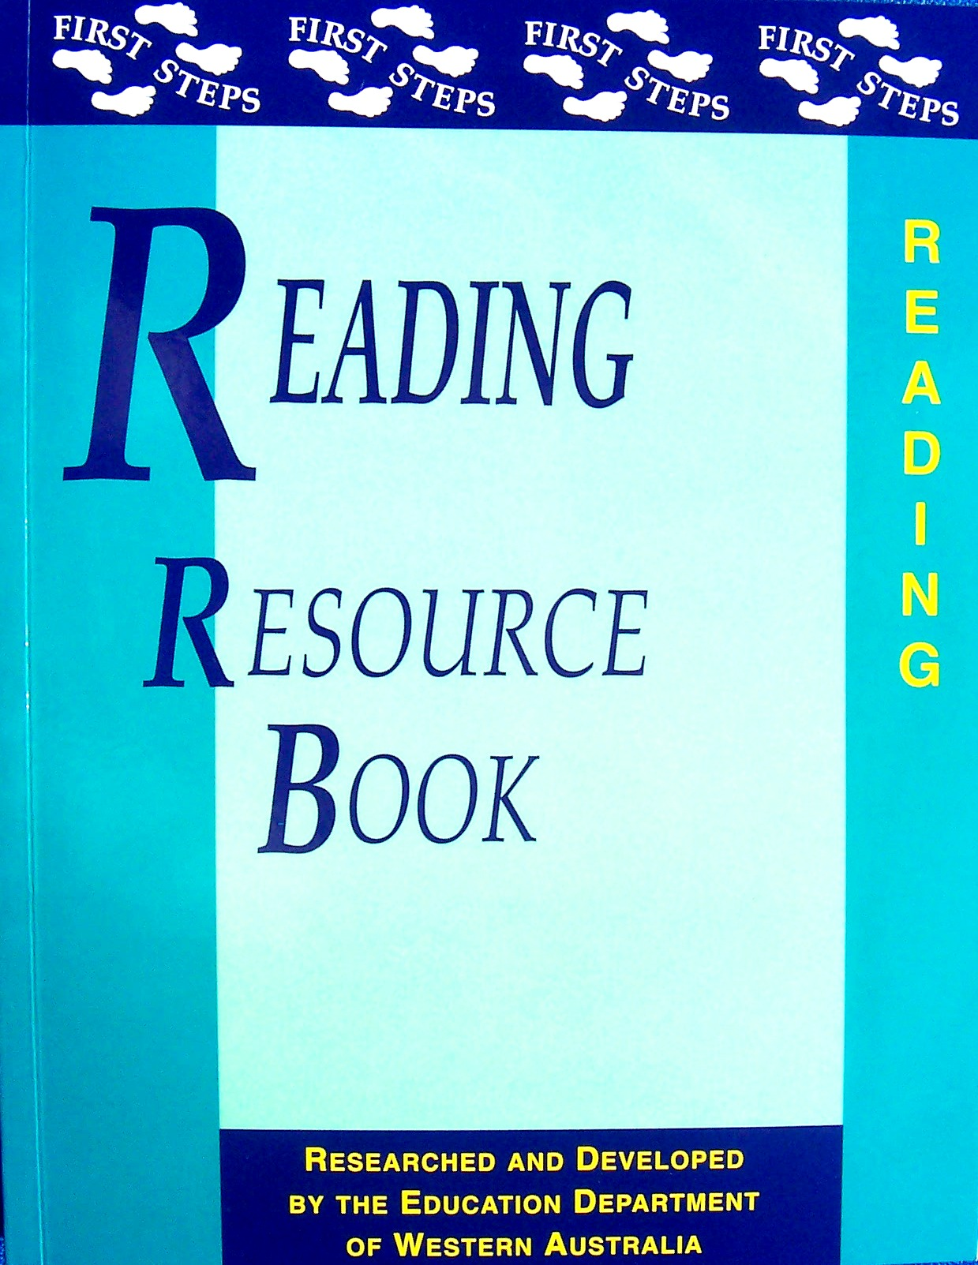
Notes:
Books such as this are appearing in Malaysian educational institutions.
Click for “First Steps”
First steps is a part of the Curriculum Framework system introduced first into Australia in the early 1990’s and has been continuously developed to this point today. It represents the centrepiece of educational reform in Australia, then in turn the UK and USA.
Click for “WA”
It was first produced and introduced in Western Australia. I was privileged to be there in WA when this first hit the schools. It arrived accompanied by a barrage of wide-ranging reforms in Australian education which we will see in a moment, and ongoing Professional Development for teachers around the world. First Steps is consummately student-orientated, forcing the user to consider students’ individual needs and backgrounds.
Click for slide 5

Slide 5
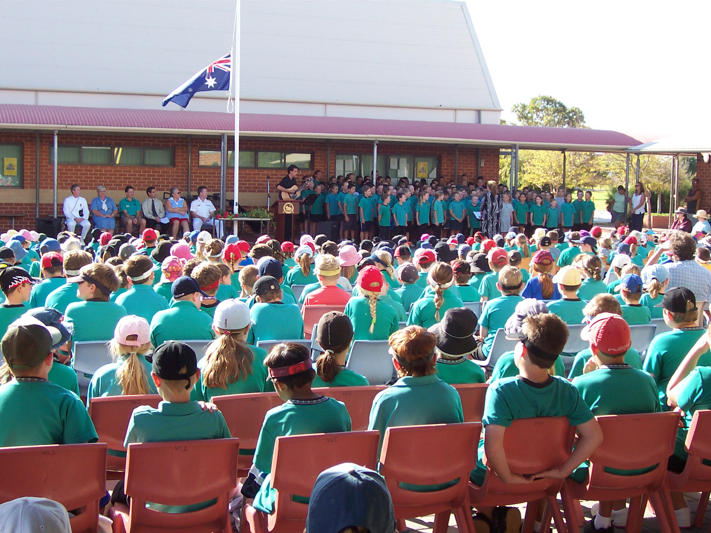
Australia 1974-77 & 1990-2004 school teaching
Notes:
An essential piece of information is my movements and activities from the 1970s to the 1990s and beyond.
I began teaching in a variety of Western Australian schools in 1974. My first year was spent in Aboriginal education in the north of Western Australia, and the following three in mainstream primary schools.
Click for slide 6

Slide 6
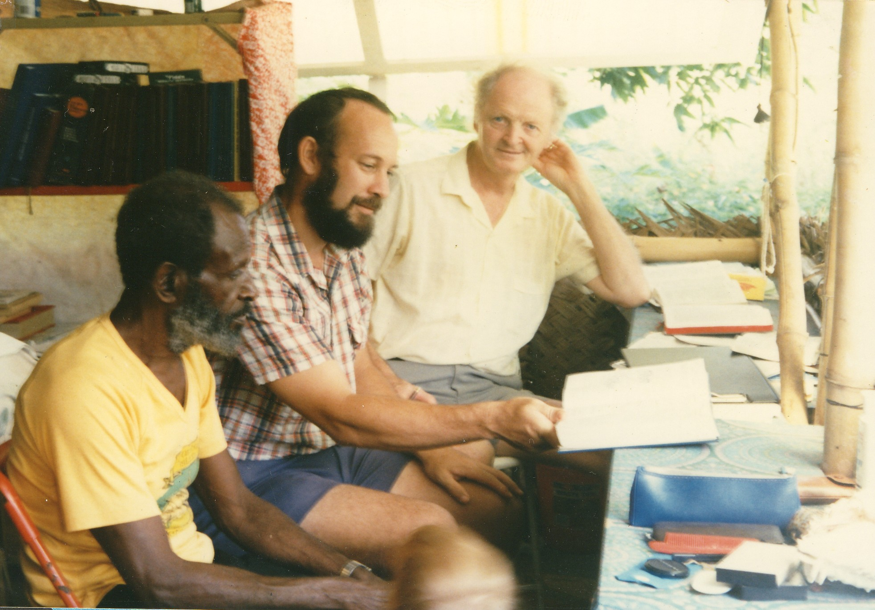
Torres Strait 1981-89 Linguistics & Literacy
Notes:
After three years of retraining, I lead a program of linguistic study and literacy in the on Murray Island in the Eastern Outer Torres Strait between Australia and Papua New Guinea.
This continued until December 1989.
Click for slide 7

Slide 7
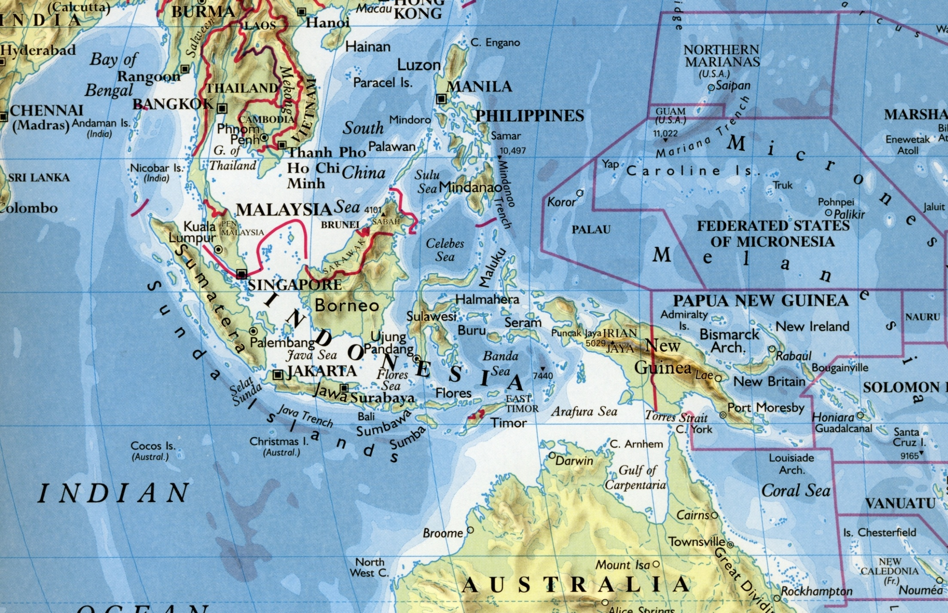
Notes:
You will see that the Torres Strait lies just south of the Equator in Oceania, just within Australian territorial waters.
Click for slide 8

Slide 8
Australia 1974-77 & 1990-2004 school teaching
Notes:
As the program in the Torres Strait drew to a close in 1989, I returned to school teaching in Western Australia, and continued in that occupation until 2004
Click for slide 9

Slide 9
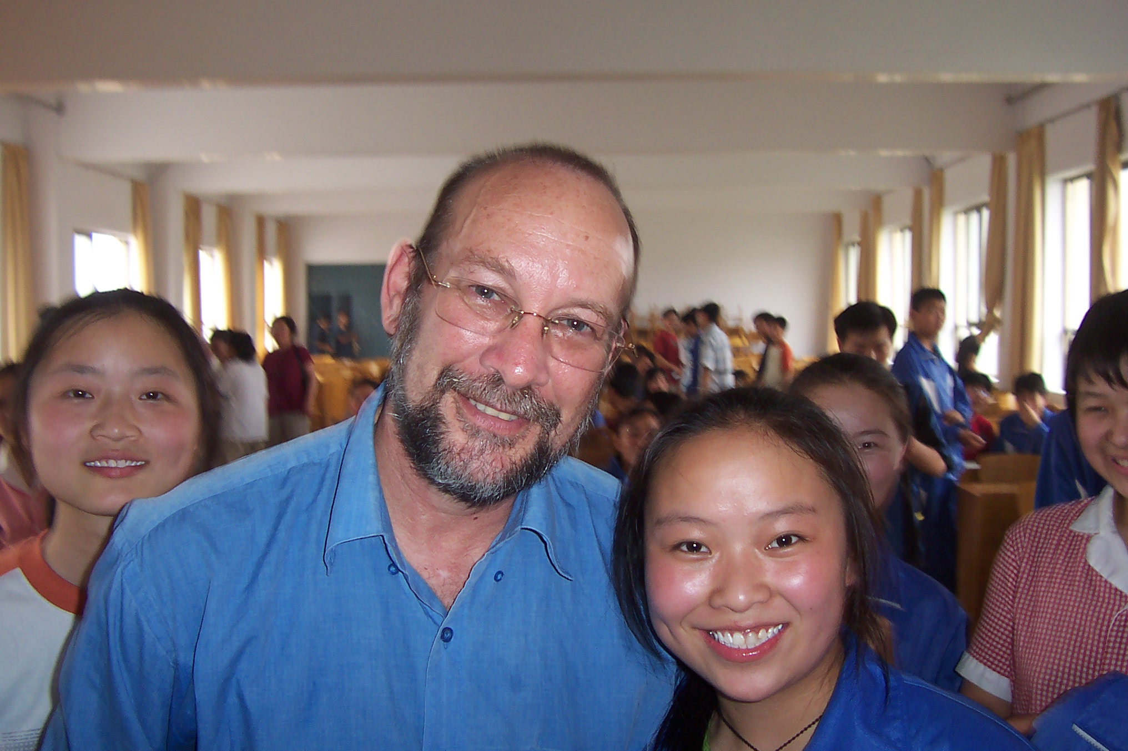
China 2004-5 EFL teaching
Notes:
After more retraining I changed educational tack and moved to China to take up a career in teaching English to Chinese students.
Click for slide 10

Slide 10
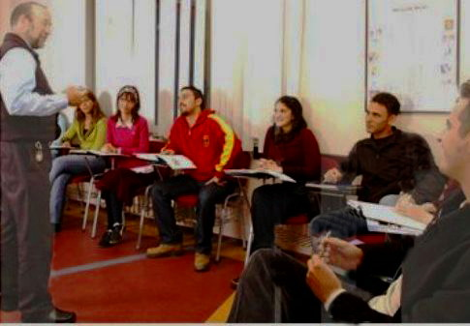
Turkey 2007 EFL teaching
Notes:
...and then on to Turkey to teach English to adults
Click for slide 11

Slide 11
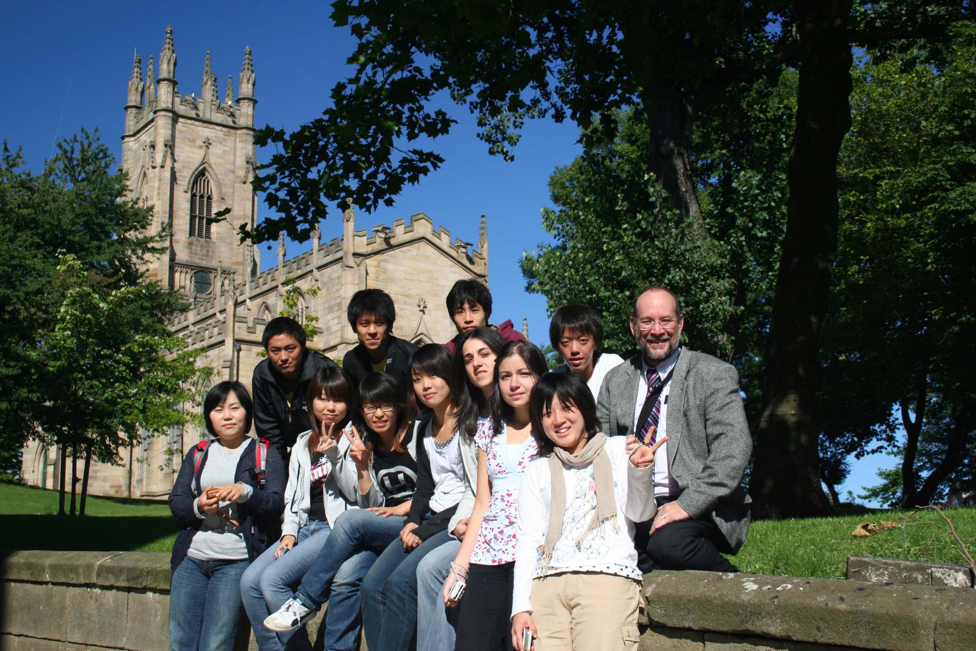
UK 2008 ESL teaching
Notes:
...and Universities in the UK
Click for slide 12

Slide 12
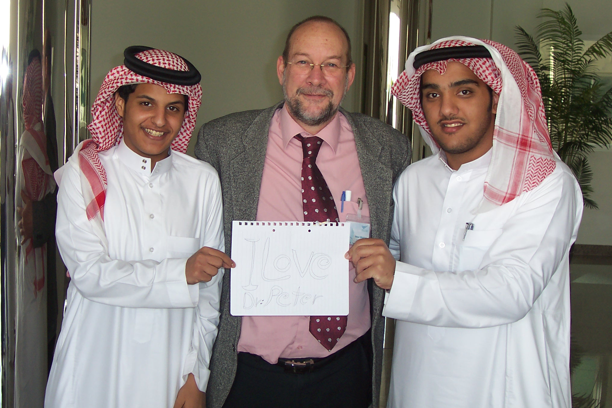
Saudi Arabia 2009 Foundation Coordinator
Notes:
...and on to managing an English foundation course in Saudi Arabia...
Click for slide 13

Slide 13
Malaysia 2011 English Language Training Fellow
Notes:
...and now on the Malaysia as an English Language Training Fellow
Click for slide 14

Slide 14
Australia 1974-77 & 1990-2004 school teaching
Notes:
Now after that brief resume of my educational career, I invite you back to 1990 when I returned to school teaching after a 12-year excursion in the Torres Strait.
All my reading and academic writing for those 12 years was occupied with linguistics and translational techniques. I had not kept up with educational reform or regulation.
The outward appearance of schools was much the same as I remembered from 1977; students were herded into classrooms where a teacher took charge from 9am to 3pm. Teachers still took refuge in the staffroom during break times unless they were unlucky enough to be rostered to patrol the school grounds on playground duty.
But soon enough the reality become obvious to me that things were not the same at all.
Click for slide 15

Slide 15
The “New” Australian Education in 1990
1. Accountability
2. Smoking
3. Registration and Qualification
4. Curriculum Framework
5. Reporting and Assessment
6. Gender Ratios
7. Customer Focus
8. Educational Funding
9. School Autonomy
10. Student Individual Differences
Notes:
I have listed 20 of the changes to Australian education that has occurred during my 12 year absence. I was like a human time capsule. In effect I was awakening in 1990 after a 12 year sleep, transported forward in time to a world that had continued to advance and refine itself while I slept. This list is far from exhaustive; the sheer number of differences from 1977 to 1990 points up the changes that took place in that period. As I continued teaching to 2004, many of these differences consolidated and extended.
Click for 1. Accountability
Possibly the first thing I noticed was accountability processes. Right from my first day back on the job I was assigned to an Accountability cohort where I was scheduled for meetings and from-filling exercises wherein my planning, assessment and recording plans were scrutinized and refined. I discovered that all teaching staff and all administration staff were now subject to the same process. Accountability for personal conduct with all stakeholders had been tightened. Teachers no longer seemed to enjoy the same status in society as they had in 1977. By 2004 when I again left school teaching, allegations of misconduct in WA were compulsorily followed up by investigation by a private investigator who reported directly to the Director of Education. Curiously, the teaching services of Queensland and New South Wales at the same time were in the process of relaxing misconduct processes.
Click for 2. Smoking
At about the same time I noticed the absence of cigarette and cigar smoke in the staffroom. Smoking was now banned in all rooms. Over the next few years it was also banned from all Education Department premises including all buildings, grounds and vehicles. As an asthmatic this came as a welcome surprise. Smoking on duty had become a reportable and punishable offence for a teacher.
Click for 3. Regulation and Qualification
In 1973 when I first qualified as a teacher, my 3-year Teaching Diploma was the normal qualification for a primary school teacher. By the mid 1990s it was a four-year Bachelor of Education. New teachers now needed this 4-year degree. By the early 2000s even returning teachers needed the 4-year qualification. Along with this, teachers since 2004 have needed to be registered by the College of Teaching in their Australian state in order to be employed as a teacher in a government Primary or Secondary school.
After teaching overseas I returned to Australia to complete my 4-year degree, and added to it a Master of Education. Teaching English in a Tertiary and Further Education college now requires a Post-Graduate Certificate. There are very few 3-year qualifies teachers left in Australia now that Baby Boomers are retiring from teaching in great numbers.
Click for 4. Curriculum framework
My search for the familiar Program Sheets of 1977 lead me to a dusty storeroom where they had lain unused for several years. The concept of grabbing a ready-made plan for a subject along with a ready-made course book was already rejected and dead in the water. First Steps and the Curriculum Framework had replaced what I had always accepted as the normal way of constructing a program of work. The Curriculum Framework, as its name suggests, is a state-approved framework of Outcome Statements that maps out a logical progression of Knowledge, Understanding, Skills and Appreciation through which a learner typically moves from the Unknown to the Known. First Steps developed over several years in the Curriculum Framework through a series of revisions and versions as the result of much field work and feedback from teachers in government and private schools. Non-exclusive rights to First Steps was sold to authorities in The USA and Britain where it continued to be developed and adapted to local requirements.
In this year of 2011, Australia for the first time has issued a National Curriculum in the eight learning areas to be used by all states, and naturally uses the Curriculum Framework as its pivotal document.
Click for 5. Reporting and Assessment
Already in 1990 as I returned to the classroom, assessment and reporting was beginning to conform to the Curriculum framework. Within a few years most schools had abandoned formal exams and opted for student portfolio presentation that addressed items from the Curriculum Framework. Each portfolio item carries a statement of learning Outcomes addressed. Younger students needed considerable teacher input with regard to choice of items; older students were given more personal latitude for their choices. Indeed, the art of matching pieces of work to Outcome Statements became in itself a learning curve for teacher and student alike. Each student’s portfolio followed them from school to school and sometimes from sate to state, and portfolio items were replaced as items showing more advanced learning appeared in the course of learning.
This is, of course, an intensely personal and individualised approach to assessment and reporting. It has the great of eliminating exam stress. It also allows a student to present their best work that often displays personal attributes that exams alone can rarely reveal.
Click for 6. Gender Ratios
In 1977 males represented around 50% of primary school teachers in Australia. By 1990 that figure had fallen to around 40%. Today it has fallen further to around 20%. Although twice that figure are male high school teachers, it is apparent that the proportion of male Australian teachers is continuing to plummet. I was welcomed back into the WA teaching service in 1990 amid increasing fears that many Australian children were growing up with no male at home (due to the rising number of single mother families) and no male teachers (due to falling male teacher numbers). Government incentives for more male students to train for the teaching service went unheeded.
Click for 7. Customer Focus
In 1977 schools were largely seen as places where teachers practiced their art of teaching. Principals were the boss of the school. Students did as they were told by teachers. Parents trusted teachers and administrators to teach their children everything they needed to pass exams and progress to the next year of learning.
By 1990 the writing was on the wall for schools and education. Parents and Citizens associations were already gaining power and control of certain aspects of school resources. When a P&C supplied a resource in 1977, that item became Education Department property as a gift. Now in 1990 it remained P&C property to be used or disposed of by the P&C. By 2004 School-Based Decision Making Groups had become mandatory in all government schools, with wide-ranging powers over curriculum, fund-raising and School Improvement schemes. The whole of the local community was now included in the list of stakeholders. Environmental concerns were now the concern of the local school; all decisions about care of school grounds were now shared by environmental support groups, welfare agencies and other governmental bodies.
Click for 8. Educational Funding
In 1977 schools were funded by the state government and by the P&C. By 1990 schools were also being funded by some private enterprises. As computer technology became an increasingly necessary part of education, so the need to supply computer hardware and software for classrooms. Computer companies had begun demanding exclusive use of their products in return for free or cheap computer resources.
Fast food companies had begun supplying free of cheap food for sporting and other events in schools in exchange for free advertising for their products in the school newsletter. By 2004 private companies had begun offering free work experience for high school students in a formal contract that dictated school curriculum to favour training for their future employees. Schools were now controversially charging school fees for “free” education, sending debt collectors to harass defaulting parents. This issue is still hotly debated all over Australia. Just yesterday the Australian Scholarships Group reported in the press that for a child born in 2011 it will cost parents $76k to educate that child in a public school and $490k in a private school from K-12.
Click for 9. School Autonomy
The early 1990s saw the first few Merit Selection Schools appear in WA. Each of these government schools for the first time could choose their own teaching staff based on the merits of their application. For these schools, seniority was no longer a binding parameter in deciding which teachers were appointed to which schools. This scheme gave the school greater autonomy to choose and gain the staff it needed, and gave teachers with more advanced skills and training the opportunity to be appointed to schools previously out of their reach. For instance, teachers stuck in country locations could now leap over more senior teachers to gain appointment in these schools if they possessed better qualifications or could prove advanced skills. These schools were also granted greater autonomy to administer school funds at the local level, typically though the School-Based decision Making Groups mentioned earlier.
Click for 10. Student Individual Differences
In 1977 there was a general operational practice among teachers that one wrote a program of work that catered for the average student, with some allowance for more gifted students and some allowance for less gifted students. By 1990 this approach was unacceptable. Each student had to be advanced in their learning. Less able students needed an Individual Learning Plan, as did all more able students. Gone were the days of “they just won’t pay attention in class” being a reasonable teacher excuse for a student under-achieving. Gone were the days of “they are not learning because they already know it all”. Every student had to show advancement through the Curriculum Framework for the teacher to have adequately done their job.
Click for 11.

Slide 16
The “New” Australian Education in 1990
11. National Testing
12. Occupational health and Safety
13. Educational Theory
14. Educational Outsourcing
15. Tenure for teachers
16. Cost Centres
17. New technology
18. Class Sizes
19. Duties Other Than Teaching
20. Professional Development
Notes:
Click for 11. National Testing
The 1990s saw the first National Assessment Program Literacy and Numeracy (NAPLAN) testing take place. At first this was presented as an Education Department assessment tool in Australia, for ascertaining levels of literacy and numeracy in various parts of Australia. From the outset, unions all over Australia opposed this testing, predicting an economic and cultural stratification of Australian education which would eventually draw wealthier parents to certain “better” schools which would then become wealthier and even “better” through better funding. To a large extent these predictions have come to pass. What began as representative testing of classes has become a means for schools to accept of reject prospective students for enroling in the school. They have also become a means of determining future government funding for each school. In some states, teachers have refused to administer these tests.
Click for 12. Occupational Health and Safety
Oc H&S by 1990 had risen to prominence to such an extent that school programs of work had been severely compromised by fear that the school, the Education Department and/or the teacher would be sued if a mishap injured a student. Duty of Care had become paramount in the thinking of any teacher planning any activity that involved and substance, tool or activity that could conceivably be used in such a way as to injure anyone. By 2004 the “kneejerk reaction” had become the norm every time a mishap occurred. As Australia became more litigious, the expectation of legal action over perceived failings in Duty of Care dictated that every mishap required an action that addressed reducing the risk of a recurrence. I witnessed whole playgrounds being removed from service because one child had slipped and injured themselves. I saw skipping ropes banned because a child had been struck by one. I even saw the game of Marbles banned in one school because there was a dispute about one child stealing another child’s marbles. Every school had its own OcH&S Representative and Committee to keep tabs on dangers around the premises.
In 1977 it was recommended that teacher watch their classes carefully. Times that classes were unattended by a teacher should be kept minimal. By 1990 it had become necessary for every student to be supervised at all times. Similarly, no teacher was to be along with any student at any time.
All classrooms in Australia are now air-conditioned where at all possible.; in 1977 air-conditionng was considered a luxury.
Click for 13. Educational Theory
The 1980’s – which I missed by living and working in the Torres Strait – was a fascinating times educationally. Much foundational educational theory that we take for granted today – Krashen(1981) with his five hypotheses of language acquisition, Gardner (1983) with his theories about multiple intelligences and de Bono (1985) with his Six Thinking hats had barely begun to surface in educational institutions by 1990, but influenced educational practice increasingly by 1990. The study of human thought and learning styles has been fundamental to the development of student-centred education. This was unknown in 1977 still in the making in 1990, but instilled into teaching practice in 2004 when I left school teaching to launch my career as an ESL teacher and administrator.
Click for 14. Educational Outsourcing
Outsourcing of secondary and higher education had begun to appear in Australia in 1990 but was still in its infancy. Since the mid 2000s this has blossomed into a full sub-industry. In particular, Universities now regularly outsource their English Foundation courses to private companies. Educational incursions by private into all levels of schools since 1990 have become commonplace. In many cases these incursions have replaced the traditional excursion whereby students would travel out of the school grounds to experience realia in society. The cheaper, safer and less time consuming incursion has become the norm. As I have wandered the world since 2004 this phenomenon of outsourcing in education has been particularly noticeable. English as a Second language (ESL) has become a fully recognised industry, with compatible qualifications appearing on university course lists.
Click for 15. Tenure For Teachers
Loss of tenure by teachers occurred sometime in the 1980s and continues to this day. The incidence of fixed-term contracts of between 6 months and 3 years has been extended from temporary teachers who replace teachers on leave to all new teachers. Merit Selection Schools had appeared by 1990 and continue to gain popularity today. School teaching in Australia is no longer the safe and comfortable job that it was in the 1970s. Tenure is now sought and gained for relatively short periods of around 3 years at all levels of teaching. As Baby Boomers have continued to exit the industry through retirement, the number of teachers who have the luxury of continuing in perpetuity has dwindled to an insignificant few. Teachers in Australia are now required to compete on the open market to retain their jobs in both government and private schools.
Click for 16. Cost Centres
Cost Centres managed by teaching faculty were introduced soon after 1990. Teachers now shouldered the extra responsibility of administering funds to run the eight learning areas, either individually or in committees. This was no longer the sole responsibility of formally appointed administrators such as principals and deputy principals. A certain level of autonomy accompanied the responsibility, allowing teachers to have more authority to distribute funds within their teaching area and make executive decisions about selection of educational resources. These cost centres included such previously such non-included areas as school grounds, school libraries and school canteens. In 2011 the traditionally volunteer position of Canteen Manager is a paid position. The imposition of stringent health and Safety regulations has rendered volunteer managers virtually impractical.
Click for 17. New Technology
New technology appeared as if by magic in 1990 as I made my reappearance into mainstream education. Computers, photocopiers, Overhead Projectors, video, mobile phones, air conditioning in classrooms and whiteboards were being utilised in Australian schools by 1990. These fostered in new possibilities for pedagogical method that were impossible dreams for teachers in 1977. Since then the irresistible march of technology has continued with CDs, DVDs, ever more powerful, lightweight and cheaper computers included computer Tablets and Smart Phones, USB srorage devices, Smart Boards, WiFi installation, live streaming, educational software and the whole range of software applications that now encompass social networking websites that can be incorporated into the learning experience by the “tech-savvy” teacher. It appears that the modern teacher ignores this technology at their own peril.
Click for 18. Class Sizes
Reduction of maximum class sizes has continued in Australian schools. In 1977 no more than 37 students could be legally taught in any one class; this had recently replaced a figure of around 50. In 1990 that figure had dropped to 32. By 2004 it had continued its downward way to 30. In 2005 that figure became 28, with the maximum for early childhood and also high school set at 24. Newly built schoolrooms are much smaller than their counterparts from 1977.
Click for 19. Duties Other Than Teaching
Duties Other Than Teaching (DOTT) time was a new concept in teaching in 1990. Two to three hours a week were allocated to specialist Arts, health and Physical Education and Languages Other Than English (LOTE) teachers to allow classroom teachers time to prepare, report and conference.
Click for 20. Professional Development
Professional Development (PD) for all teaching staff was scheduled regularly in 1990. By 2004 this had become compulsory, with minimum limits set for PD in each year. Funds for PD became available through specific grants from the Departments of Education. School closure days were scheduled so that whole staff PD could be accomplished more easily. None of this existed in Australia in 1977.
Click for slide 17

Slide 17
The New IPG:
student centred learning
A New IPG – The Winds of Change
The Winds of Change in Australia 1990 and Beyond
The “New” Australian Education 1990
Reaction to Educational Change in Australia 1990
Reaction to Educational Change in Malaysia in 2011
Notes:
Now that is a lot of change to take in. Some of it is clearly a change for the better. Some of it seems to be a step backwards as a reponse to a changing society.
Much of it is still in a state of change, evolving towards (hopefully) a better system of education.
Certainly at the time, my reaction was a bit like this:
Click for slide 18

Slide 18
Reaction to Educational Change in Australia 1990
Notes:
The beneficial aspect of copping all of those changes in one massive hit is that I could accurately reflect on the changes.
Fortunately, most of us experience such reform in a more gradual fashion, over a number of years. This feeling of confusion and loss of perspective can be greatly diminished through an ongoing Professional Development that keeps us abreast of the times.
Click for slide 19

Slide 19
The New IPG:
student centred learning
A New IPG – The Winds of Change
The Winds of Change in Australia 1990 and Beyond
The “New” Australian Education 1990
Reaction to Educational Change in Australia 1990
Reaction to Educational Change in Malaysia in 2011
Notes:
Click for Reaction the Educational Change in Australia
Chairman Mao of China declared that in China was “like 8 or 9 o-clock in the morning” (Li 2006). He was referring to his country as an emerging nation after radical changes to its foreign policy and internal organisation. We are left to ponder where Malaysia is educationally in 2011.
Malaysia, and particularly Terengganu, is recognized as being populated by a tradition –orientated society. Things change slowly. This of course can be both a strength and a weakness. The strength is that valuable aspects of local culture are protected from loss. Individuals are spared the culture shock of displacement. The weakness is that areas of endeavour such as education can lag behind the rest of the world where rapid change is taking place in response to changing social, economic, environmental and political status.
Some educational reform seems to have taken place in Malaysia. But from all indications from the kinds of terminology that is currently being used, much more is on the way.
The only question is whether you are affected like this:
Click for slide 20

Slide 20
Reaction to Educational Change in Malaysia 2011 ?
Notes:
Or like this...
Click for slide 21...

Slide 21
Reaction to Educational Change in Malaysia 2011 ?
Notes:
...or, through inaction and frustration, like this...
Click for slide 22

Slide 22
Reaction to Educational Change in Malaysia 2011 ?
Notes:
Or looking and feeling laid back about the prospect of educational reform, through constant reassessment of our world
Or perhaps even like this:
Click for final slide 23

Slide 23
Reaction to Educational Change in Malaysia 2011 ?
Notes:
... Or feeling excited and fulfilled
... Leaping headlong into the deep water of change
...accepting change as a natural and exciting part of the process of our own education
...immersing ourselves completely in the changes and feeling comfortable in this new element.
It is really up to you
I wish you well in this exciting and challenging time.
Thankyou

