Slide 1
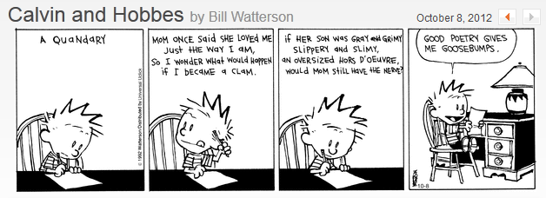
Poetry for Kids
Notes:
Poetry isn’t just for grownups …

Slide 2
This lesson covers:
Poetry Types
Poetry Forms
Strategies
Notes:
Some people get confused between types and forms. Forms is about what it looks like, the metre etc. Type is about the purpose.

Slide 3
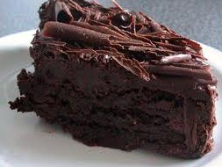
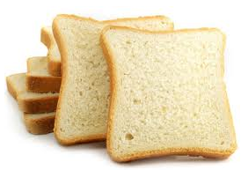
How is poetry different from prose?
Rich chocolate cake
Plain white bread
Notes:
Sometimes poetry looks a lot like prose. But the language is much richer. Like chocolate cake compared to plain white bread.

Slide 4
3 Types of Poetry
Lyric
Thought and emotion
Some songs
Eulogy, ode, sonnet
Does not tell story
Notes:
Basically 3 types of poetry:
First type of poetry – lyric.

Slide 5
3 Types of Poetry
Lyric
Narrative
Tells a story
Ballads, epics
Heroic events of cultural significance
Notes:
Second type of poetry – narrative. Lots of children’s poems are narrative.

Slide 6
3 Types of Poetry
Lyric
Narrative
Dramatic
Written in verse that is meant to be spoken
Tell story or portray situation
Usually in blank verse
Notes:
Third type – dramatic. Usually in blank verse / free verse, but not always.

Slide 7
(Some) Forms of Poetry
Acrostic
Concrete
Cinquain
Free Verse
Haiku
Limerick
Sonnet
Clerihew
Which ones are good for children?
Notes:
Some people say there are 55 forms, some say there are more. People tend to make up new forms and new names. Here are some of the interesting ones.

Slide 8
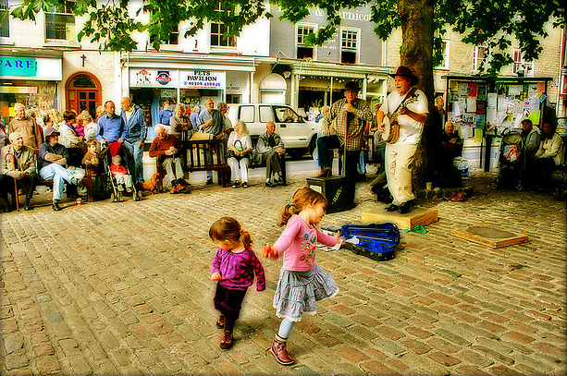
Why teach poetry?
to children?
rhyme
rhythm
language
enjoyment
Notes:
Children need to learn about rhyme, helps them with their phonics and reading.
It’s very important for kids to feel rhythm, developmentally for their brains.
Learning poems and learning about poetry with help their language development.
And poetry can and should be really fun for them, anything that is fun will improve their learning.

Slide 9
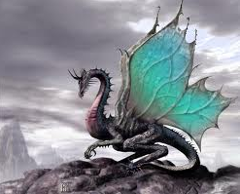
Acrostic Poem
The dying sun is leaving with the light
High in still air o’er the mystic hill
Evening fast is changing into night
Red hued skies their bloody crimson spill
Every blade of dew-drenched night-blacked grass
Bends and whispers till the soft dusk sings
Each wild creature breathes not till they pass
Dragons flying high on mighty wings
Riding over darkling tower-topped Tor
Ancient Avalon where Arthur lies
Guarding He who they are waiting for
Once and future King who never dies
Now when all things change and fade from sight
Sunset is the time of dragon flight
Notes:
This is an acrostic poem – a very long, complicated one. (It’s also a sonnet).

Slide 10
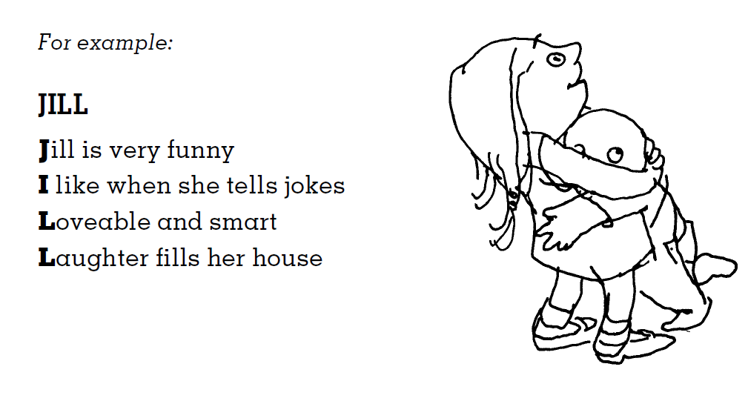
Name Acrostic Poem
Notes:
This is a more normal kids acrostic poem, based on some kid’s name.

Slide 11
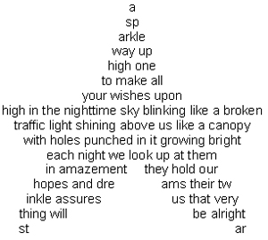
Concrete Poem
Notes:
Concrete poems (or shape poems) are all about the shape, but the words should be good too.

Slide 12
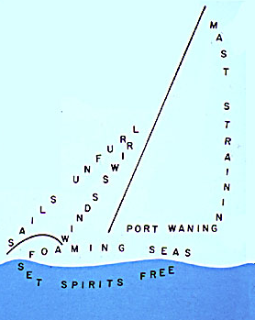
Concrete Poem
Notes:
This concrete (shape) poem is quite a nice little poem even without the visual effect.

Slide 13
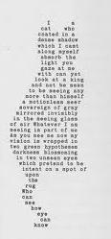
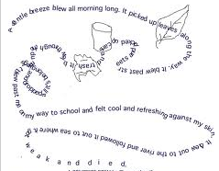
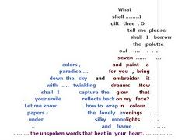
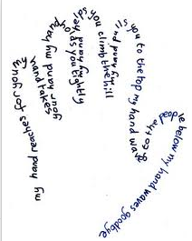
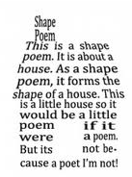
Sometimes called “Shape Poems”
Notes:
Several more concrete / shape poems.

Slide 14
Cinquain
Line A: One vague or general one-word subject or topic. Line B: Two vivid adjectives that describe the topic. Line C: Three interesting “-ing” action verbs that fit the topic. Line D: Four-word phrase that captures feeling about the topic. Line E: A very specific term that explains Line A.
NOTE: ‘cinq’ is French for ‘five’.
Notes:
A useful form for a short poem – 5 lines – that can be created in the classroom following a particular formula.

Slide 15
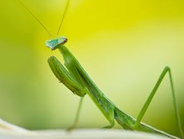
Insect Hidden, hungry Preening, searching, stalking Waits as if praying Mantis
Notes:
An example of a cinqain poem.

Slide 16
Free Verse
The fog comes
on little cat feet.
It sits looking
over harbour and city
on silent haunches
and then moves on.
by Carl Sandburg
Notes:
Free verse, or blank verse, has no rhyme. Not a lot different from prose, just richer maybe.

Slide 17
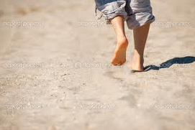
Haiku Poem
3 lines, 5 / 7 / 5 syllables
I walk across sand
And find myself blistering
In the hot, hot heat
Notes:
Haiku poems are often used in the classroom because they are short and simple, and have a formula to follow.

Slide 18
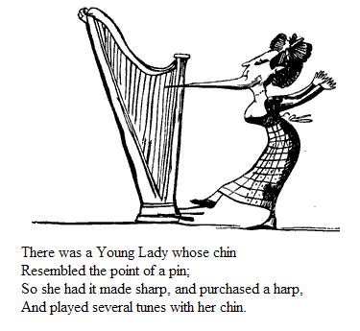
Limerick
Notes:
Limericks are supposed to be funny, and follow a very strong formula. Probably not so easy for ESL.

Slide 19
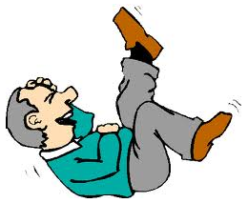
Limerick
There was a young man from Dealing Who caught the bus for Ealing. It said on the door Don't spit on the floor So he jumped up and spat on the ceiling
Notes:
Another example of a limerick.

Slide 20
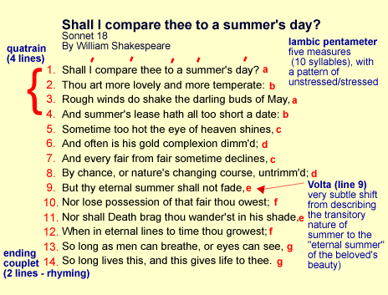
SONNET 1
Shakespearean
Notes:
Sonnet – Shakespearean. Very definite rhythm and rhyme formulation. Difficult for primary school, although they might enjoy listening to it if well-read.

Slide 21
SONNET 2
Petrarchan
Notes:
Petrarchan – the other type of sonnet.

Slide 22
Clerihew
Clerihews have just a few simple rules:
They are four lines long.
The first and second lines rhyme with each other, and the third and fourth lines rhyme with each other.
The first line names a person, and the second line ends with something that rhymes with the name of the person.
A clerihew should be funny.
Notes:
Short little four-line poems. Can be fun for kids to try writing.

Slide 23
A Clerihew
The enemy of Harry Potter Was a scheming plotter. I can't tell you what he's called; I'd be ashamed To name "he who must not be named."
Notes:
Example of a Clerihew.

Slide 24
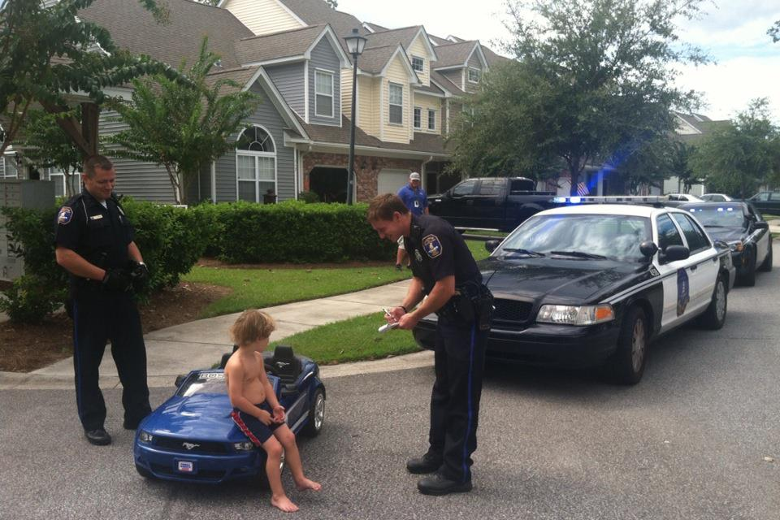
Don’t Forget Poetic Devices!
Which poetic devices should children learn about, and why?
Notes:
Should children be taught about poetic devices, or is that too adult for them?

Slide 25
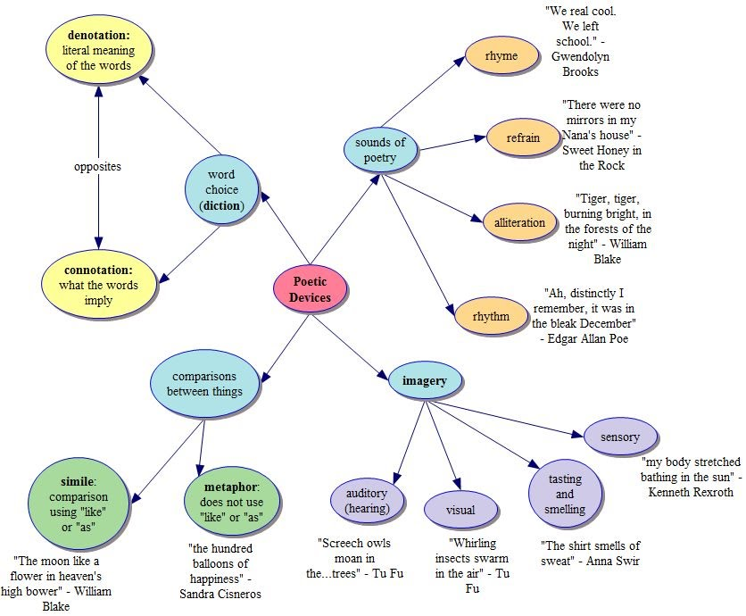
Notes:
Chart of poetic devices.
The ‘sounds of poetry’ section is important for children.
The ‘imagery’ is useful, though they don’t need to learn the terms.
‘Comparison between things’ – children can practice their language with, for example, similes.
‘Diction’ may be beyond primary school children.

Slide 26
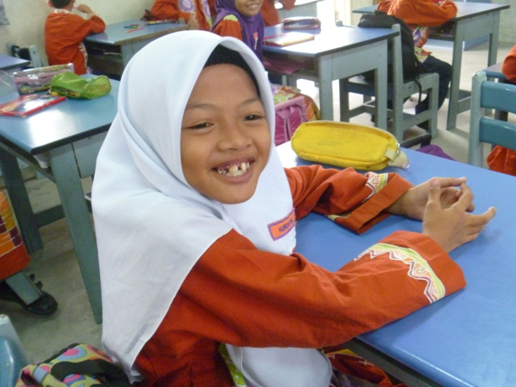
Strategies?
Poems for Kids
Notes:
So how do we teach poetry to kids like this one.

Slide 27
Strategies?
Read Poems to them
Get them to read poems (silently/aloud)
Get them to memorise poems
Get them to recite poems
They respond to poems with actions
They respond to poems with artwork
They respond to a poem by dramatizing it
They compare poems
They listen to lyrical poems (in songs)
Notes:
Here are some strategies.
Reading poems to them needs preparation and enthusiasm. We are going to practise reading some now in class.
Try to read each line, hold it in your head, and look up to speak.

Slide 28
Strategies?
Get them to write their own poems …
Write an acrostic name poem
Make a shape poem
Use a poetic device in a simple poem
Work together to create a group or class poem
Display poems children have written
Find poems on the Internet
Put your class poems on the Internet
‘Found Poetry’ – make a found poem
Notes:
Getting them to write poems – with careful preparation they can do this.

Slide 29
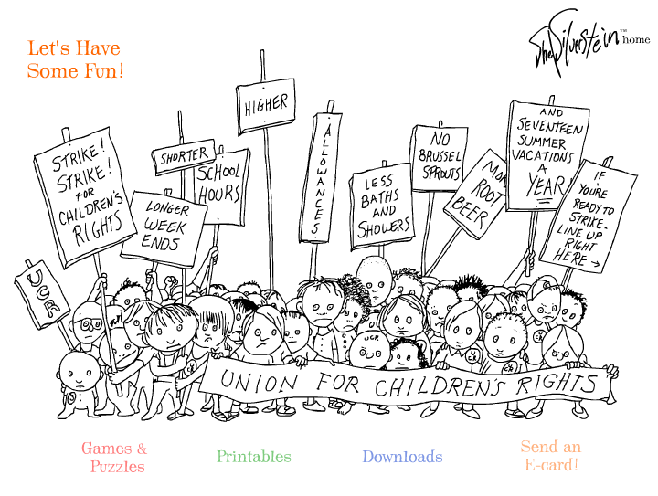
http://www.shelsilverstein.com
Notes:
Some websites to look at.
Shel Silverstein writes great kids’ poems.

Slide 30
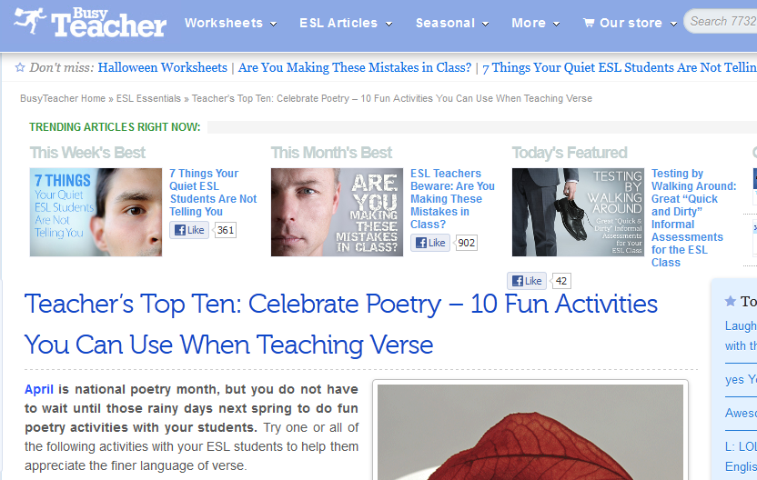
http://busyteacher.org/7031-10-fun-ways-teach-poetry-classroom.html
Notes:
Busy Teacher – register and use (it’s free)

Slide 31
http://www.poemhunter.com/poems/
Notes:
Poem Hunter has some good poems and ideas.

Slide 32
http://teacher.scholastic.com/writewit/poetry/
Notes:
Scholastic has poems and ideas.

Slide 33
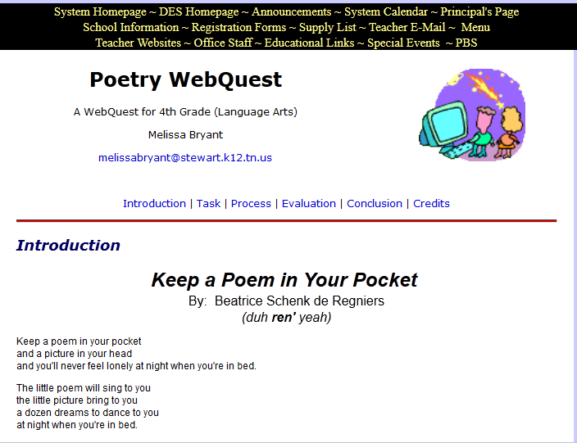
http://www.stewartcountyschools.net/des/Poetry%20WebQuest.htm
Notes:
This crowd has a “poem in your pocket” thing.

Slide 34
Project
Write 3 poems
in 3 different forms
(at least one with rhyming)
ruth.wickham@gmail.com

