Slide 1
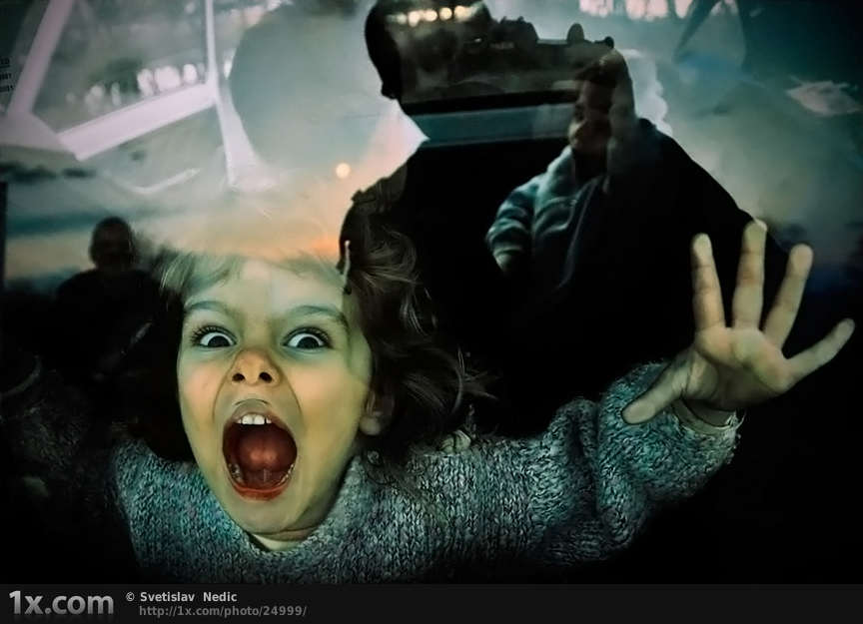
Theatrical Storytelling
Infusing your Storytelling with Drama

Slide 2
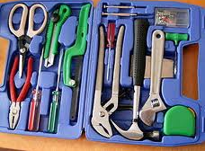
Tools of the trade
mime / actions
voice
sound effects
position
facial expressions
props

Slide 3
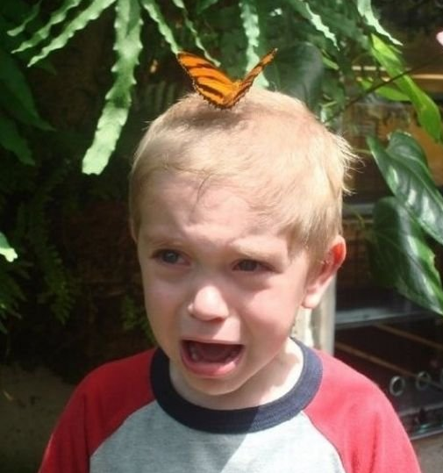
It’s OK to be AFRAID
BUT DO IT ANYWAY!

Slide 4
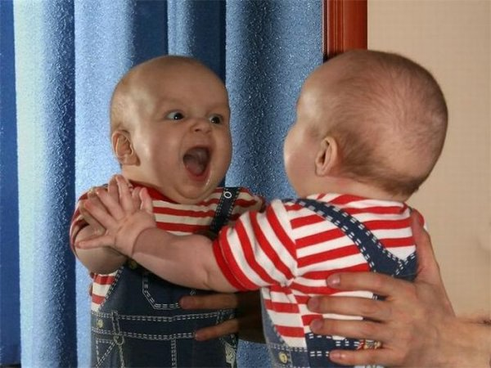
Visualisation
Notes:
a) Getting Started
First we need to choose a story – as has been discussed in previous sections. We could think of a well-known folk-tale, or a story we have heard. We could choose a story in a book (but remember that we are going to tell the story, not read it aloud). We could make up a story.
NOTE to facilitator
Story Choices – for this exercise participants may have a story of their own choosing, or be given a random story sheet from the facilitator. The random stories are just the bare bones of a story for them to build on.
We need to KNOW the story really well. That does NOT mean memorise it as such. Only memorise the sequence of events.
And we need to be able to visualise it – the scenes, the characters, the actions. Visualise and be able to describe how each character moves and talks.
We need to use imagination to make the story real and complete.
NOTE to facilitator
Participants should discuss with group members what they know about their story. The participant’s notebook contains questions for thought but it is not expected that they would try to write anything down at this time.

Slide 5
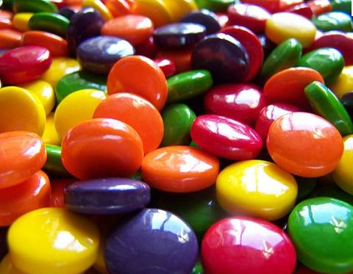
Five Senses
Notes:
c) Five senses
Storytellers are often reminded to “Show, don’t tell”. The audience should be made aware of how things look and feel, including colours, smells, tastes, and textures. “Showing” may involve using a literary device such as a simile or metaphor rather than straight-out description. Storytellers endeavour to paint a picture with words.
A good story will have three to five sensory descriptions.
Facilitator should model a short colourful descriptive passage.
Participants take notes about adding descriptive passages to their storytelling and discuss it with their group.

Slide 6
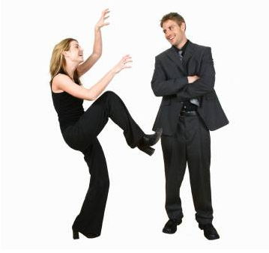
Mime
Notes:
b) Mime
Most people find mime a little awkward and even difficult. But this is a very important step in preparing the story for telling. As Gere says:
“Bad storytelling is often static and word- based. Children respond to physical movement and it enlivens the tales. Mime forces the storyteller to start learning scenes and to visualize the story.”
The facilitator should model how to mime a story first.
The storyteller needs to become the character and mime the scenes.
After a demonstration by the facilitator, participants should go to a private spot nearby to mime and once there they should close their eyes and explore the scenes in their story. Allocate a specific amount of time (20 minutes should be enough) and tell participants to return promptly.
NOTE to facilitator
Participants may be quite comfortable to work in the course room as everyone is concentrating with their eyes closed. This would make it possible to ring a bell or give some other signal for them to return to their places.

Slide 7
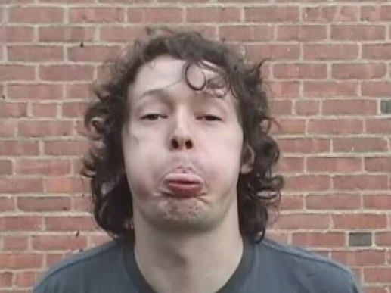
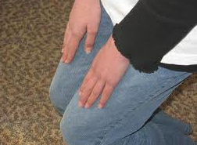
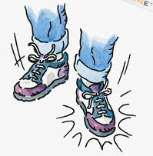
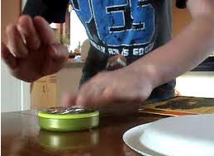
Sound Effects

Slide 8
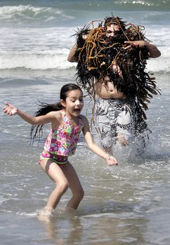
Props:
things you can use to make your story come to life (even more).

Slide 9
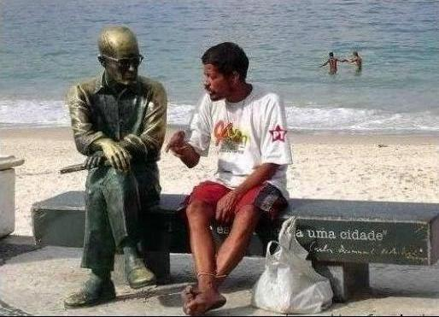
Words
Notes:
d) Words
The trick is not to lose the actions and sounds when we add the words.
Facilitator should model this step. Tell part of a story using actions, sound effects and words as well.
The participants should now work in pairs, telling each other their stories using actions, sound effects and words. The listener needs to give feedback. Facilitator should monitor.
Listener Feedback
The listener needs to ask questions about parts that are difficult to visualise, if it’s not clear who is speaking or what is happening.
Participants should each pair up with another partner and try again.

Slide 10
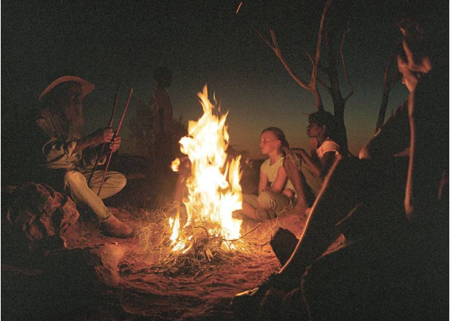
TELLING the story
Notes:
4. Telling the Story
Of course the following aspects of storytelling also need some practice, but by now everyone is beginning to feel the need to get on with telling the story.

Slide 11
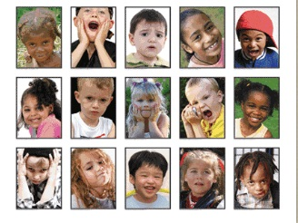
Character Voices, Faces, Placement
Notes:
a) Character Voices, Faces, and Placement
We have already practised movements and sound effects, and had listener feedback to tell whether it was obvious who was doing what in the story.
Dialogue can really liven up a story, but when telling the story, it becomes tiresome for the narrator to be saying “Now the cat says … and then the mouse says … and then the cat says …”
So to keep the audience informed about who is talking when, the storyteller needs to keep the characters clear in space and in relation to one another. Each character should have a position where the teller stands/sits/bends down, and each character should have specific facial expressions, gestures, and voice quality – pitch, gruffness, vocab range etc.
Facilitator should demonstrate this with a segment of story.
Participants consider a story with a couple of characters, and plan how to depict each one.
Discuss choices with their group / partner and if necessary adapt ideas.

Slide 12
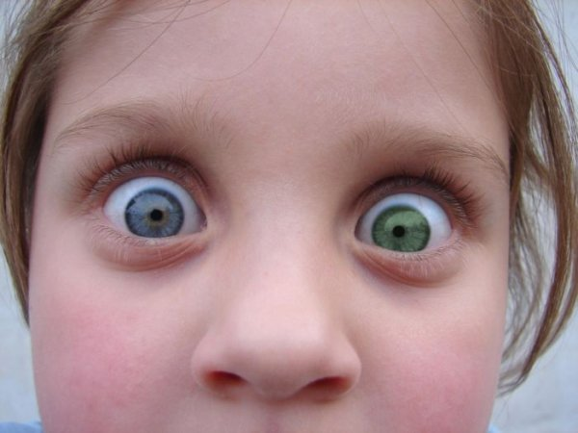
Eye Contact
Notes:
b) Eye contact
The storyteller must make eye contact with the audience. This will ‘hook’ them and keep them listening. They will each know that the storyteller is talking directly to them.
It’s a two-way street. The audience will feel the storyteller’s energy, and the storyteller will be energised as he feels the connection.
Facilitator should demonstrate this, and draw attention to the eye contact.
Give several participants an opportunity to tell part of a story to the whole group and attempt to maintain eye contact.

