Slide 1
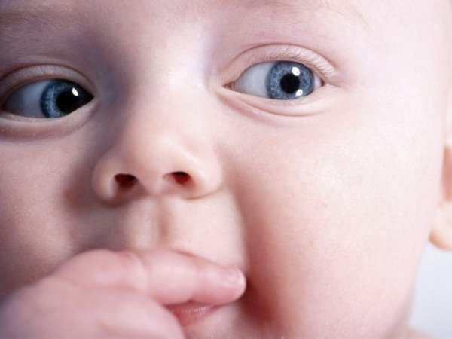
Teaching Sight Words
Reading in English for Young Learners in Malaysia
Session 3

