Slide 1
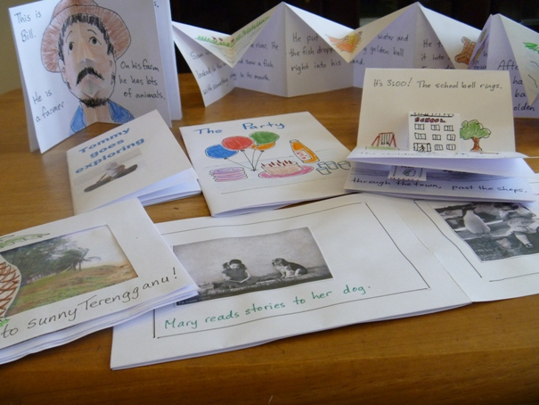
Creating Your Own Reading Materials
Reading in English for Young Learners in Malaysia
Session 8

Slide 2
THE little book
Made from a single sheet of paper
No need for staples, glue, sticky tape
Can be quickly and easily created by anyone
Can be adapted into pop-up book
Can be created on the computer in Word
Can be photocopied (one side of paper)
Sometimes called “hotdog book”, “origami book” “Poof! book” ...

Slide 3
The little book has front and back cover, and six pages. It can be made with A3 paper, or A4 paper.

Slide 4
You need:
pens/pencils
scissors
A4 or A3 paper

Slide 5
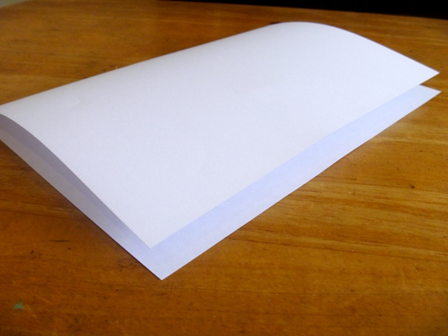
Step 1:
Fold the paper in half

Slide 6
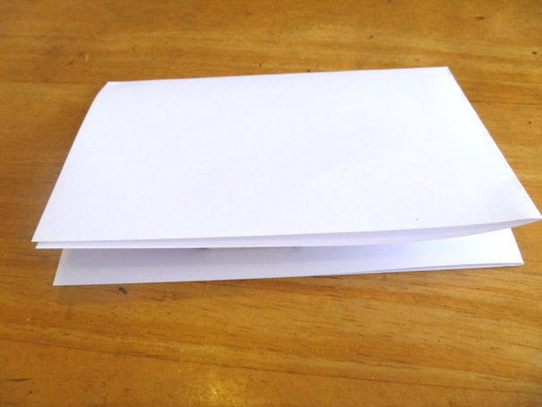
Step 2:
Fold the paper in half again

Slide 7
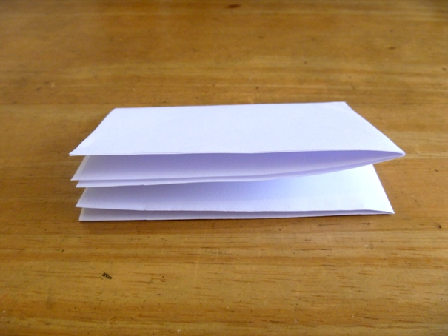
Step 3:
Fold the paper in half a third time

Slide 8
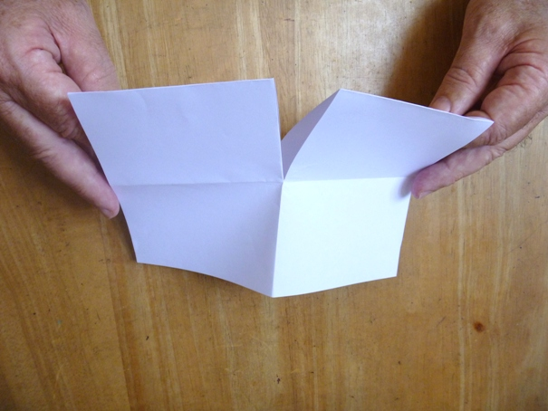
Step 4:
Unfold as far as the first fold
Cut down to the fold mark
from the fold edge

Slide 9
Step 5:
Fold
Cut section
Unfold, and re-fold the other way

Slide 10
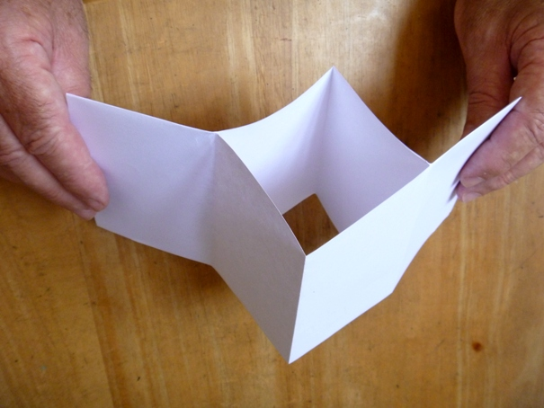
Hold the two ends ...
... and push them together.

Slide 11
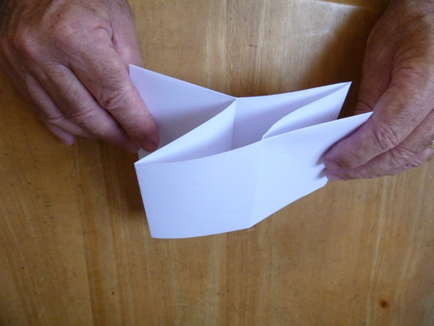
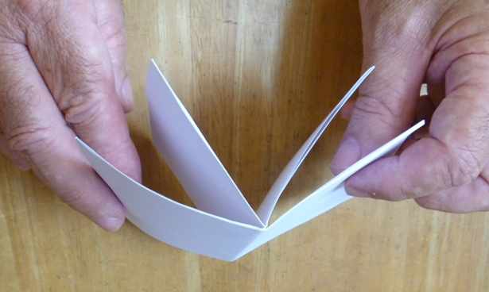
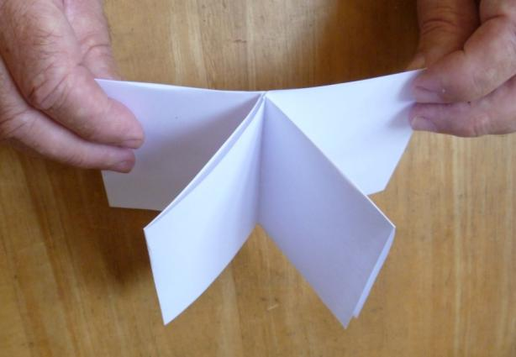
And there it is!

Slide 12
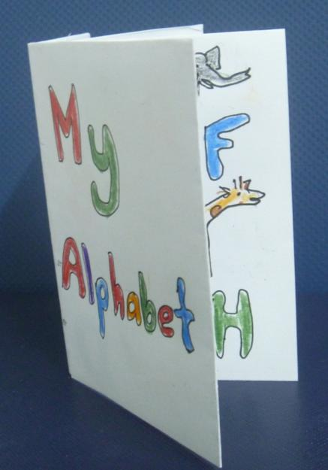
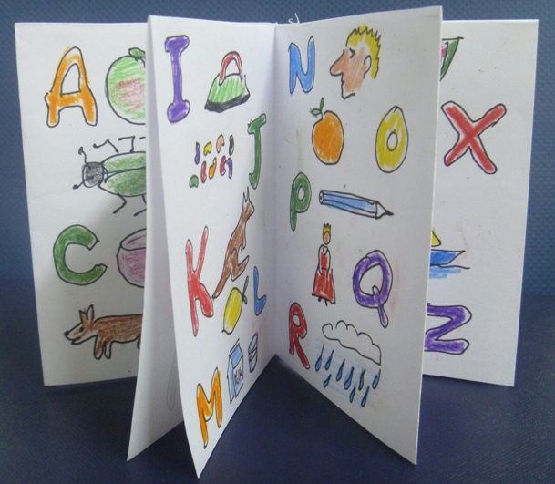
Now ... write, draw

Slide 13
Basic Story Writing
Introduce your characters with descriptions of physical and personality traits, their surroundings, and those with whom they come in contact.
Create a problem/conflict. This could be between two people, an internal conflict, or one in which the main character overcomes an obstacle in the outside world.
Write the climax of the story, which will include the main character(s) coming face to face with the conflict.
Show how your character(s) resolves the problem, and what happens next.

Slide 14
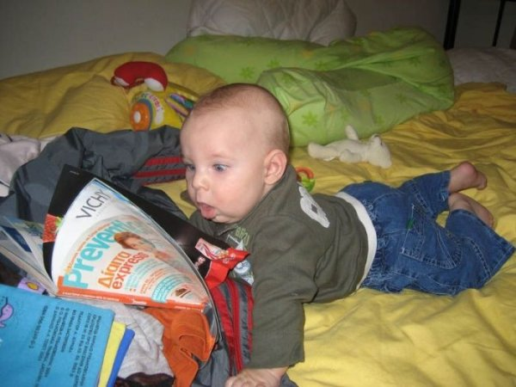
Really little kids love books and stories, but they don’t really need a storyline (problem and solution), and they don’t want anything scary!

Slide 15
Preparing for Pop-Up Books
Start simple:
Making a Pop-Up
Card

Slide 16
You need:
pens/pencils
scissors
A4 or A3 paper

Slide 17
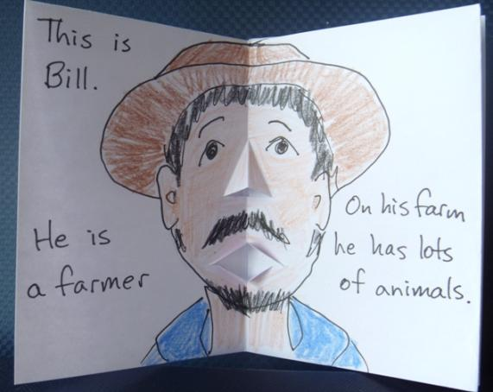
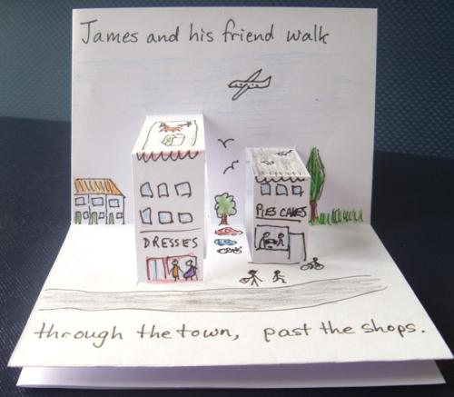
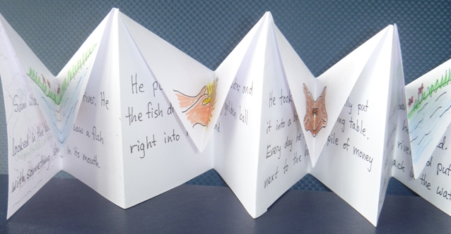
Pop-Up Books

Slide 18
You need:
pens/pencils
scissors
A4 or A3 paper

Slide 19
Step 1:
Fold the paper in half

Slide 20
Step 2:
Fold the paper in half again

Slide 21
Step 3:
Fold the paper in half a third time

Slide 22
Step 4:
Unfold as far as the first fold
Cut down to the fold mark
from the fold edge

Slide 23
Step 5:
Fold
Cut section
Unfold, and re-fold the other way

Slide 24
Hold the two ends ...
... and push them together.

Slide 25
And there it is!

Slide 26
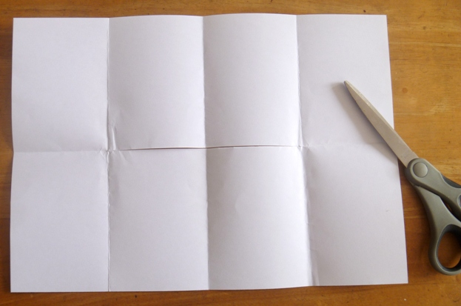
Folding for pop-ups:
Unfold paper completely
Fold edges in to the middle

Slide 27
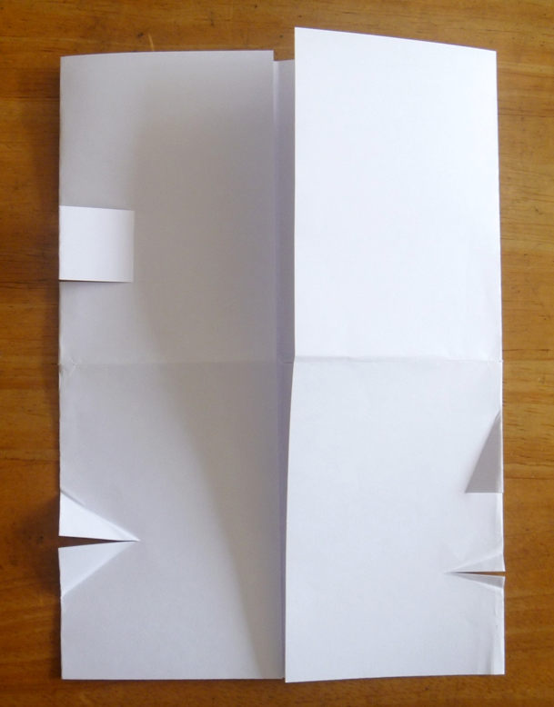
Little cuts for pop-ups:
Book Cover
(no cuts)
Box
Nose
Mouth or beak (duck)
Mouth

Slide 28
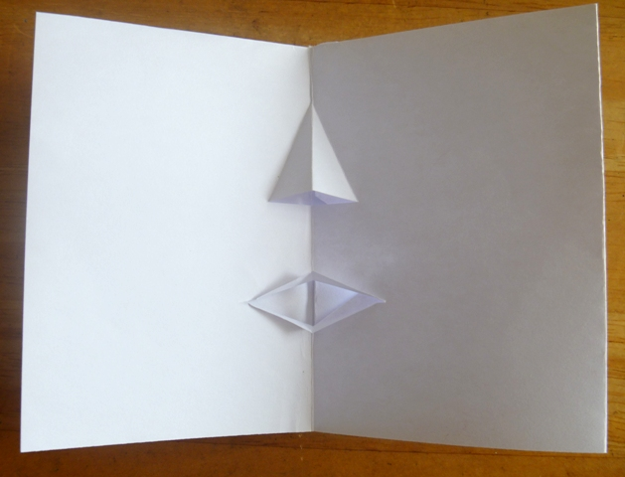
Face – nose and mouth pop-ups

Slide 29
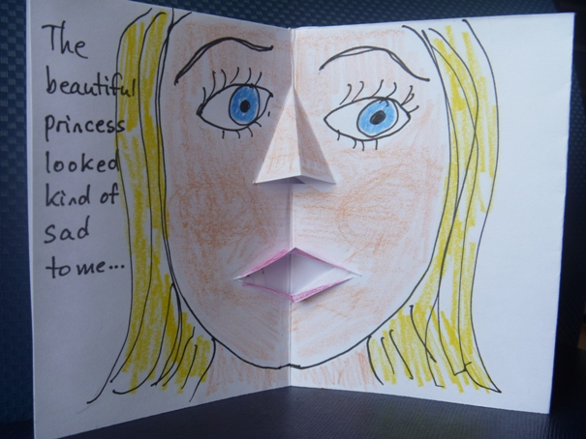
A character quickly develops

Slide 30
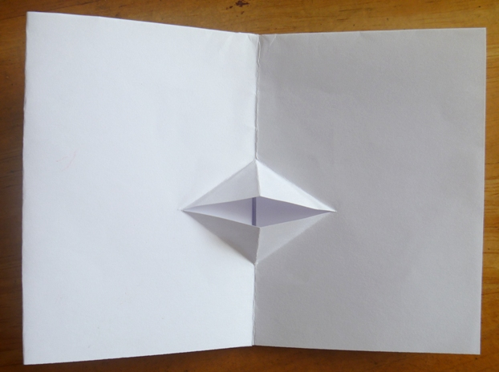
Duck Beak or Animal Mouth

Slide 31
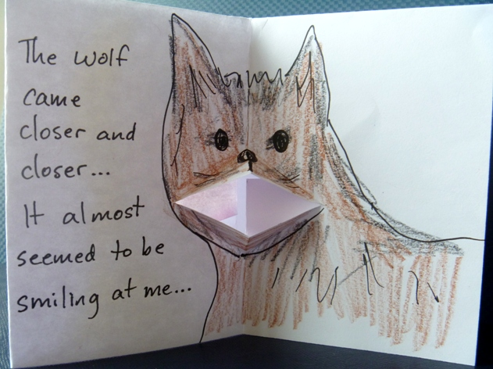
Any animal will do

Slide 32
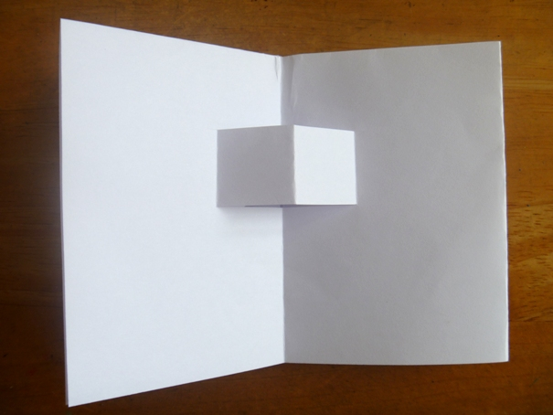
Box or Furniture or Item

Slide 33
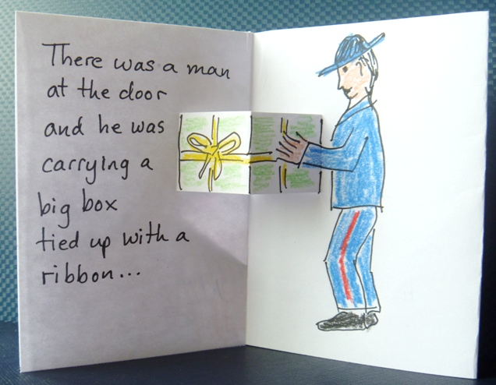
Something cube-shaped

Slide 34
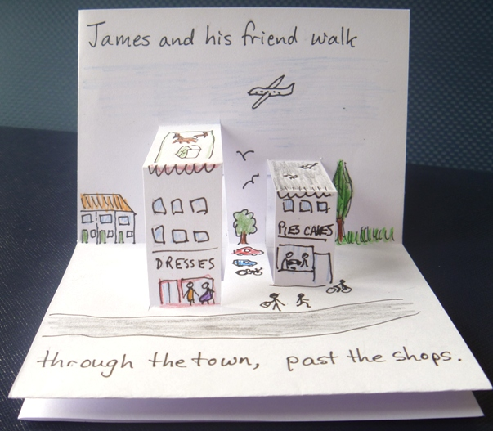
Design your story and pop-ups to go together.

Slide 35
There doesn’t have to be a popup on every page.

Slide 36
Step 1:
Fold the paper in half

Slide 37
Step 2:
Fold the paper in half again

Slide 38
Open the paper, and re-fold the other way.
Inside of Card

Slide 39
For a beak or mouth:
cut
fold

Slide 40
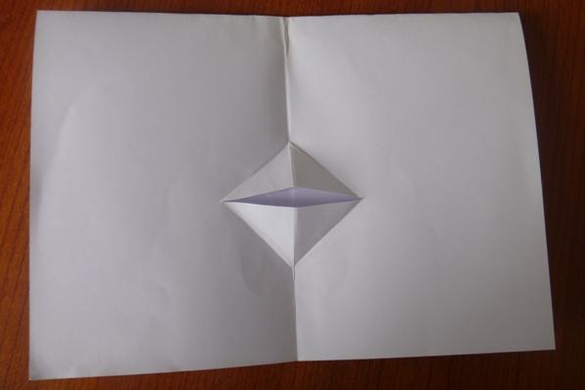
Re-fold card.
Put finger inside card to push out pop-up section.

Slide 41
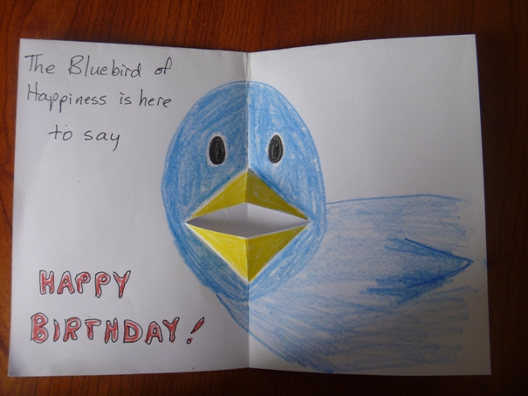
Decorate!

Slide 42
Other Shapes:
Box Shape

Slide 43
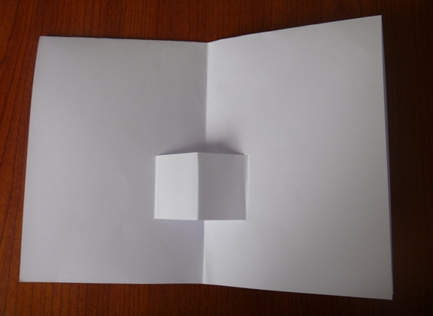
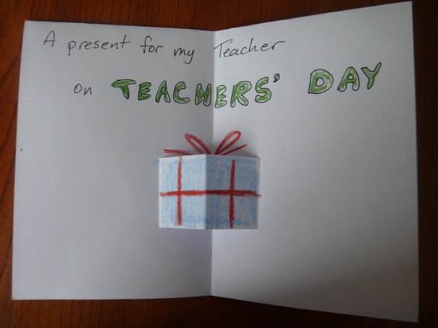
Make into a box, house, furniture ...

Slide 44
A Face:
mouth
nose

Slide 45
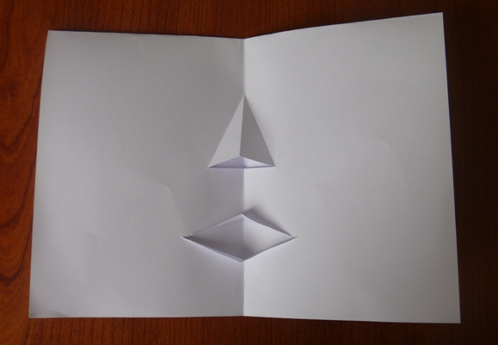
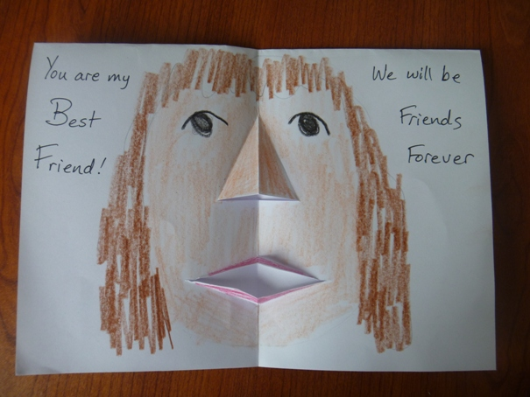
Decorate the face, create a character

Slide 46
There are many occasions that could be celebrated with a card.

