Slide 1
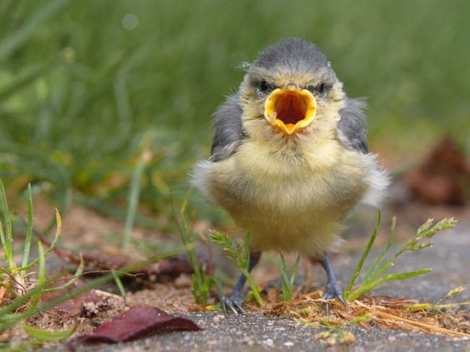
Stress and Intonation
2 hour workshop for PPISMP Sem2, IPGKDRI August 2012

Slide 2
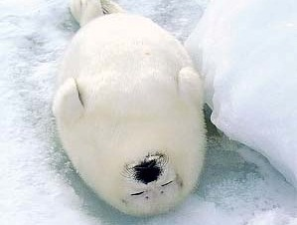
This is a WORKSHOP
Don’t even think about snoozing!
There will be an exam at the end!
Notes:
Although in this workshop there are a large number of participants seated in a lecture-style arrangement, this is still a workshop and participants will be expected to complete activities along the way, and there will also be a small examination at the end.

Slide 3
Look for your icon!
?
Notes:
Look for your icon. When you see your icon on the screen, it will be your turn to come down the front and answer a question. There are four people with each icon.

Slide 4
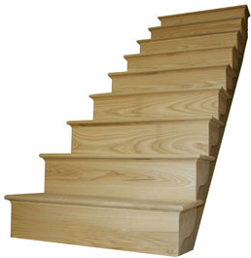
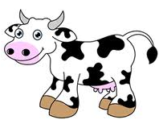
Come on down!
If this is your icon:
Notes:
This is the first icon selected. Will these four people please quickly come down to the front?

Slide 5
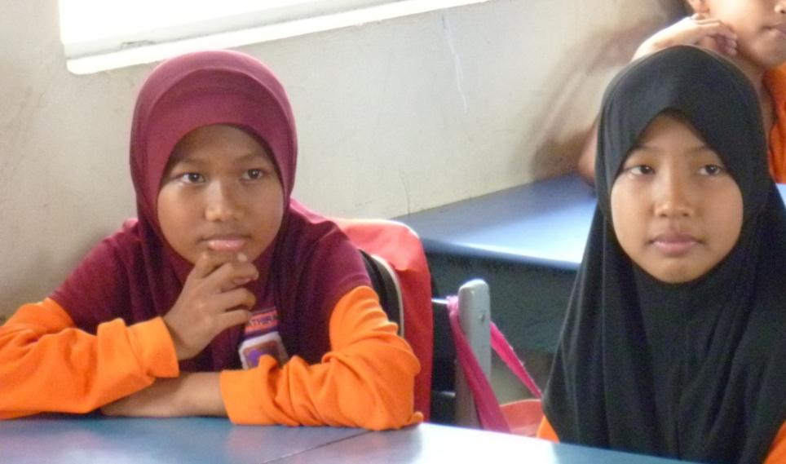
So what’s the difference?
Does BM have stress and intonation?
Notes:
How does stress and intonation work in BM?
Is it the same? How is it different?
(In BM the word order is altered rather than changing intonation – so I hear.)

Slide 6
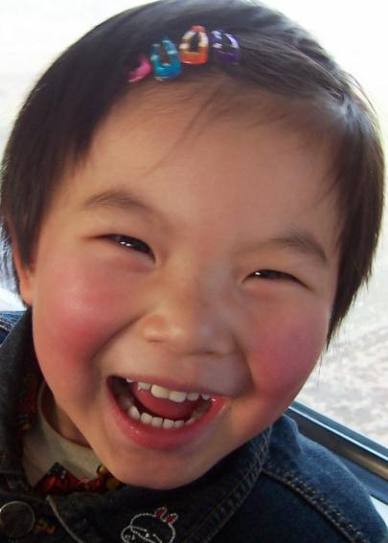
So what’s the difference?
Does Chinese have stress and intonation?
Notes:
What about Chinese? How does stress and intonation work in Mandarin, or Hokkien? (Any comments from participants.)

Slide 7
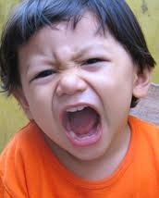
Is it important in English?
YES IT IS!!
Notes:
Because stress and intonation do not have the same function in other languages (BM, Chinese, …) people don’t always realise how important it is for speaking well and being understood in English.

Slide 8

Intonation
Sentence Stress
Word Stress
Phonemes
English Pronunciation
Notes:
Learning the phonemic sounds of English is only the beginning. We need to also master the syllable stress in words, the word stress in sentences, and the intonation that is linked to the word stress.

Slide 9

English Pronunciation:
Word
Stress!
Notes:
So first of all we are going to look at Word stress.

Slide 10
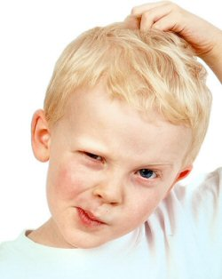
Speak clearly to be understood
Incorrect stress
can cause misunderstanding just as much as incorrect sounds.
Notes:
Getting word stress wrong can cause a lot of misunderstandings.
(For example … )

Slide 11
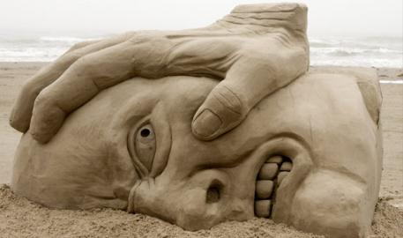
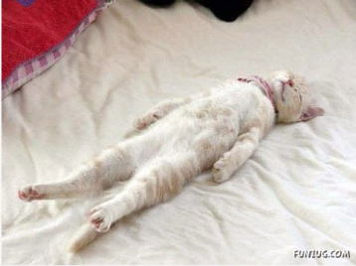
Stress and Unstress
What does STRESS sound like?
Louder
Longer
Higher
Notes:
So what do we mean by “stress”? The stressed syllable in a word is:
longer, louder, and at a higher pitch.

Slide 12
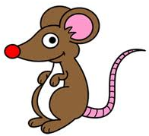
Come on down!
If this is your icon:
Notes:
Four people with this icon please come to the stage.

Slide 13



What does UNSTRESS sound like?
/ə/
er
ar
or
ure
teacher
collar
doctor
measure
a
e
i
o
u
zebra
garden
fossil
lion
circus
Notes:
What does un-stress sound like? Besides being shorter, quieter, and lower in pitch, unstressed vowel sounds often (but not always) tend to be pronounced as a ‘schwa’. This, of course, can cause spelling difficulties.

Slide 14
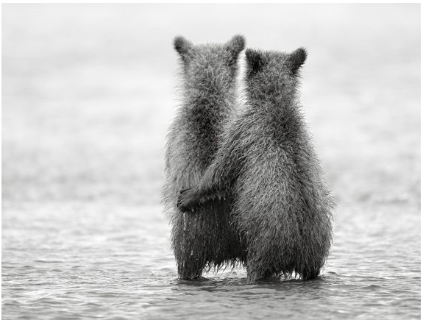
Words with 2 syllables
Notes:
Words with 2 syllables – these are the hardest to make rules about.

Slide 15

Stress on the 1st syllable:
MOST 2-syllable nouns and adjectives have stress on the FIRST syllable.
BUTter
SANDwich
Notes:
Most 2-syllable nouns and adjectives have stress on the first syllable. (Not a very reliable rule!)

Slide 16
Stress on the LAST Syllable
MOST 2-syllable verbs
have stress on the LAST syllable.
diVIDE
reCEIVE
Notes:
Most 2-syllable verbs have stress on the second syllable. This is, of course, talking about the base form of the verb.

Slide 17
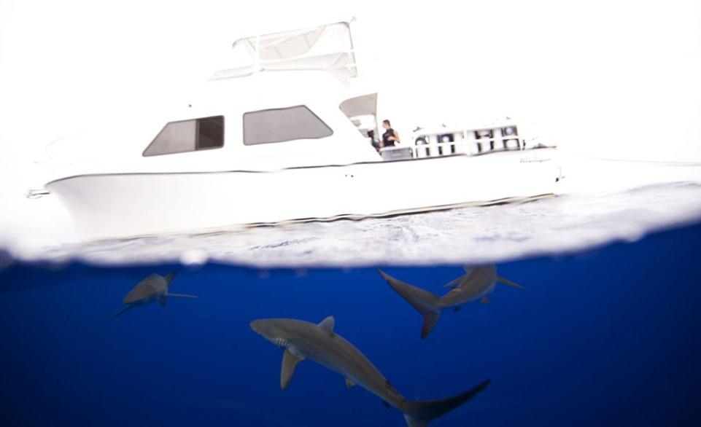
Exercise – Worksheet 1
1. Find all the 2-syllable words.
2. Decide which ones obey the ‘rules’.
Notes:
Look at Worksheet 1. List all of the words from the paragraph which have two syllables. Write the part of speech (noun, verb, adjective, adverb …) for each one. Are there any words that keep this rule / break this rule?

Slide 18
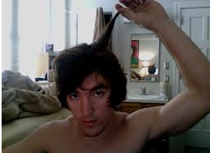
Rule Breakers?
Harry
woken
beeping
bathroom
shower
realized
shampoo
bottle
empty
early
needed
hurry
awful
deny
classroom
little
quickly
chocolate
breakfast
stuffing
backpack
because
many
carry
Billy
always
rely
rushing
startled
buzzing
alarm
police
arrived
sitting
office
having
stressful
morning
only
o’clock
Notes:
Which of the 2-syllable words are Rule Breakers?

Slide 19
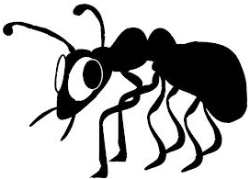
Come on down!
If this is your icon:
Notes:
The four people with this icon will come down and share their answers.

Slide 20
Rule Breakers?
Harry
woken
beeping
bathroom
shower
realized
shampoo
bottle
empty
early
needed
hurry
awful
deny
classroom
little
quickly
chocolate
breakfast
stuffing
backpack
because
many
carry
Billy
always
rely
rushing
startled
buzzing
alarm
police
arrived
sitting
office
having
stressful
morning
only
o’clock
Notes:
There are a lot of verbs with 2 syllables, but they are not 2-syllable verbs, as in having 2 syllables in the base form. However there are several other verbs which do not follow the rule – can we make a rule about them? And there are a few nouns which break the rule.

Slide 21
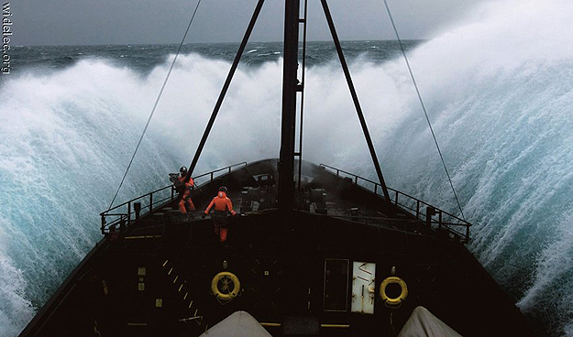
Word Stress that Changes
heteronyms
Notes:
Heteronyms are words with two different pronunciations and different meanings. Now the rule about 2 syllable nouns/adjectives/verbs becomes meaningful.

Slide 22

Come on down!
If this is your icon:
Notes:
Four people with this icon please come quickly down the front.

Slide 23
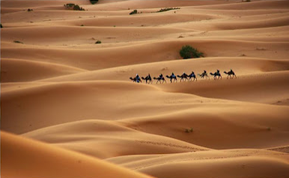
the desert - noun
Notes:
How do you pronounce this word? ‘desert’, the noun.

Slide 24

desert island - noun
Notes:
What about this word? ‘desert island’ – is it still a noun? How is it a desert?

Slide 25
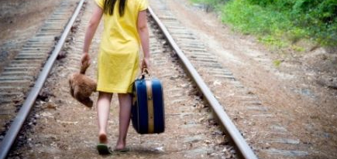
desert (leave) - verb
Notes:
How do you pronounce this one? ‘desert’, the verb.

Slide 26
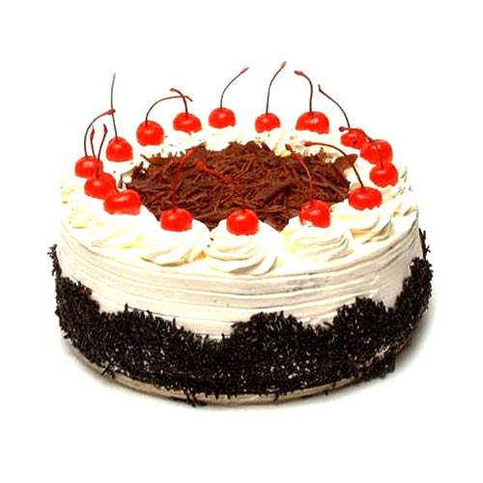
What about dessert?
Notes:
This is a different spelling of the same sounding word. How is it pronounced?

Slide 27
Worksheet 2 - 1
Noun | Verb
Export | Export
Compound | Compound
Object | Object
Address | Address
Combat | Combat
Insult | Insult
Decrease | Decrease
Conduct | Conduct
Protest | Protest
Permit | Permit
Transport | Transport
Desert | Desert
Notes:
Please look at Worksheet 2 in your workbook. These words all have a noun form and a verb form.

Slide 28
Worksheet 2 - 2
Noun Adjective Verb
Present Present Present
Perfect Perfect
Frequent Frequent
Content Content Content
Notes:
These few words also have an adjective form.

Slide 29

Come on down!
If this is your icon:
Notes:
The people with this icon can now come down and share their answers.

Slide 30
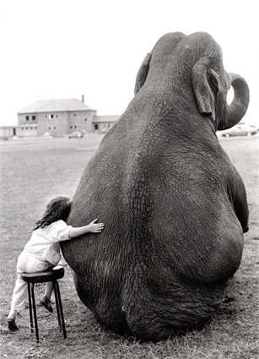
Rules for Longer Words:
Stress is attracted to certain syllables:
The stress falls on the syllable just before ...
-ic
-tion
-sion
-cion
-xion
Notes:
Word stress is attracted to certain syllables, and sits next to it. When a word contains a syllable with ‘-tion’ (in all its forms) the stress falls on the syllable just before. This is also true for words that contain ‘-ic’.

Slide 31
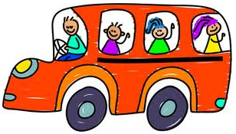
Come on down!
If this is your icon:
Notes:
If this is your icon, please come down to the front.

Slide 32
Can you say these correctly?
calculation decision
reaction solution distribution delusion
relation association operation
Notes:
The four participants now try saying these words correctly.
(click to show answers)

Slide 33
Stress before ‘-tion’/ ‘-sion’
calculation decision
reaction solution distribution delusion
relation association operation

Slide 34

Come on down!
If this is your icon:
Notes:
Four people with this icon, please come down the front.

Slide 35
Can you say these correctly?
economic terrific
strategic logic
pathogenic domestic
metabolic statistic
Notes:
The four participants now try saying these words correctly.
(click to show answers)

Slide 36
Stress before ‘-ic’
economic terrific
strategic logic
pathogenic domestic
metabolic statistic

Slide 37
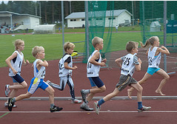
3rd Last Rules
last
3rd last
2nd last
Stress falls on the 3rd last syllable …
Notes:
3rd last rules: A lot of longer words are affected by a 3rd last rule. This means that the stress falls on the Ante-Penultimate syllable.

Slide 38
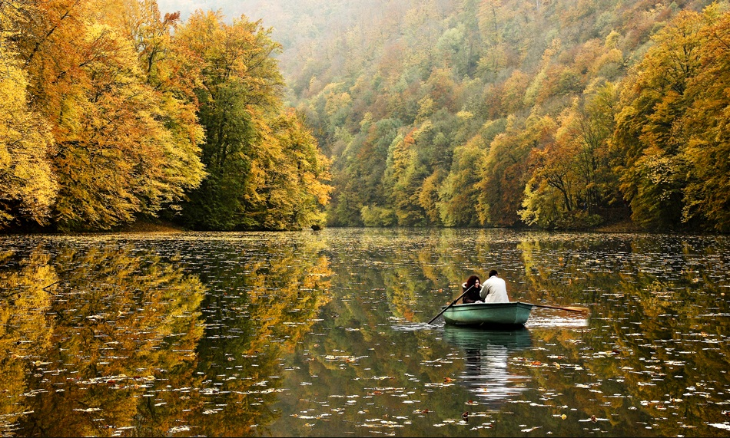
1. Words ending in consonant + y
but not ‘-ly’
tranquility
Notes:
Words ending in a consonant + y – except for ‘-ly’ have stress on the 3rd last syllable. For example the word ‘tranquility’.

Slide 39

Come on down!
If this is your icon:
Notes:
The four people with this icon can come down and try saying these words.

Slide 40
Examples
biology quality
policy democracy
geography atrophy
university choreography
photography archaeology
society equality
technology allergy
electricity clarify
Notes:
Try saying each of these with stress on the 3rd last syllable.

Slide 41
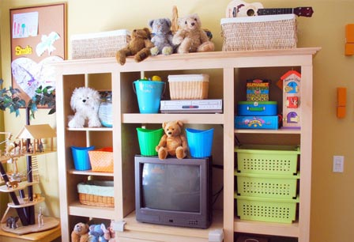
2. Words ending in ‘-ise’ / ‘-ize’
organise
Notes:
Words that end in ‘-ise’ (or American ‘-ize’) the stress falls on the 3rd last syllable. An example is the word ‘organise’.

Slide 42
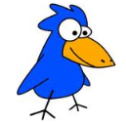
Come on down!
If this is your icon:
Notes:
People with this icon please come to the front and try saying these words.

Slide 43
Examples
accessorise acclimatise idolise advertise
agonise anesthetise anodise antagonise
apologise brutalise legalise computerise
magnetise globalise mobilise traumatise
organise dramatize emphasise energise
epitomise fantasise fertilise finalise
Notes:
Try saying these words with the stress on the 3rd last syllable.

Slide 44
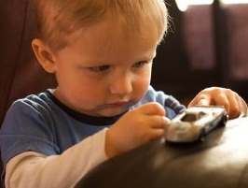
3. Words ending in ‘-ate’
concentrate
Notes:
Words ending with ‘-ate’ also have stress on the 3rd last syllable. An example is ‘concentrate’.

Slide 45
Some –ate examples
generate certificate passionate
graduate advocate separate
appropriate estimate associate
concentrate illustrate participate
immediate corporate chocolate
negotiate communicate accommodate
abbreviate anticipate delegate
Some of these are heteronyms
Notes:
Here are some examples. Try saying them with the person sitting next to you. You may (should) have some difficulties because many of them are heteronyms and you can’t know how to say them without a context.

Slide 46
‘-ate’ heteronyms
Noun Verb
graduate graduate
advocate advocate
separate separate
appropriate appropriate
estimate estimate
associate associate
delegate delegate
Worksheet 3
Notes:
These ‘-ate’ words are heteronyms. Look at Worksheet 3.

Slide 47
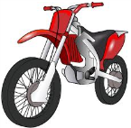
Come on down!
If this is your icon:
Notes:
The people with this icon can come and share their answers to worksheet 3.

Slide 48
Worksheet 4
What are the “Rules” for Simple Word Stress?
2 Syllable nouns and adjectives …
2 Syllable verbs …
2 Syllable heteronyms …
‘-ic’ words …
‘-tion’ / ‘-sion’ / ‘-cion’ / ‘-xion’ words …
3rd last rules:
  ‘-ise’ / ‘-ize’ words …
  ‘-ate’ words …
  ‘-ate’ heteronyms
Notes:
Worksheet 4 is an opportunity to revise all of the rules we have just learnt.

Slide 49
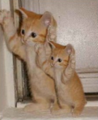
Secondary Stress
Supercalifragilisticexpialidocious
Stress alternates with un-stress.
Primary stress alternates with secondary stress.
Can you work out how to say this word?
Worksheet 5 – show the stress
Notes:
We don’t like to go more than two syllables without some stress!( In words that use the 3rd last rule, for example, the last two syllables are unstressed.) So in longer words a secondary – weaker – stress is used on syllables in between.
Can you work out the stress on this word? Look at Worksheet 5.

Slide 50

Come on down!
If this is your icon:
Notes:
Come on down if this is your icon and try saying this word

Slide 51

Primary – unstress – secondary – unstress …
SU-
per-
cal-
i-
FRAG-
il-
ist-
ic-
EX-
pi-
al-
i-
DO-
cious
Notes:
Here is the answer.

Slide 52
Primary and Secondary Stress
An-ti-bi-o-tic
As-so-ci-a-tion
Dif-fer-en-ti-ate
Phil-o-soph-ic-al
Notes:
Here are some normal longer words that use secondary stress. Can you work out where the primary and secondary stress are?
(click for answers)

Slide 53
Primary and Secondary Stress
An-ti-bi-O-tic
As-so-ci-A-tion
Dif-fer-EN-ti-ate
Phil-o-SOPH-ic-al

Slide 54
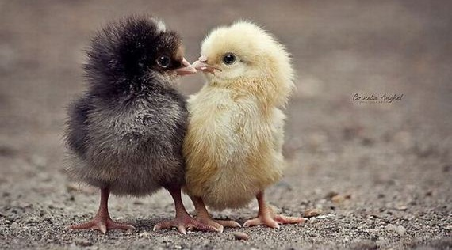
Compound Words
Nouns
Notes:
Compound words are formed by joining two other words to create one. Sometimes these words are written with a hyphen, sometimes without – the rules here are unclear.
Firstly, when the compound word is a noun ..

Slide 55
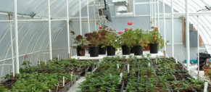
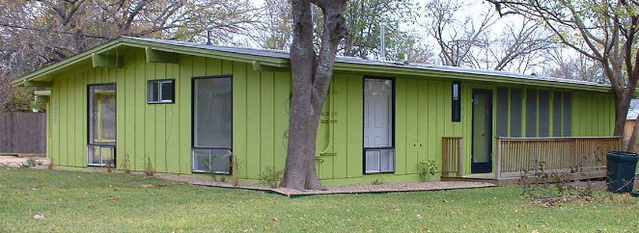
GREENhouse
green HOUSE
Notes:
Just like in the simple words, the first half of the word carries the stress. Compare this with the same two words as an adjective and noun.

Slide 56
Compound Words
Adjectives
Notes:
When the compound word is an adjective …

Slide 57
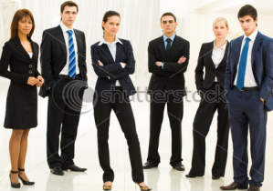
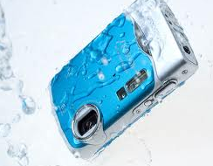
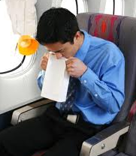
2 adjectives
Dark-GREEN
Well-DRESSED
Noun + adjective
WAter-proof
AIR-sick
Notes:
It depends whether it is formed from two adjectives, or a noun plus an adjective forming a compound adjective.

Slide 58
Compound Words
Phrasal verbs
vs
Compound nouns
Notes:
Sometimes we can become confused between phrasal verbs, and compound words made up of the same two parts. They are different.

Slide 59
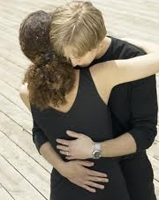
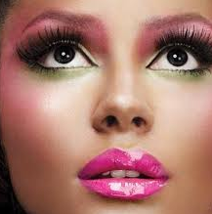

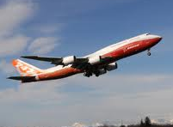
make UP
MAKE-up
Take OFF
TAKE-off
Notes:
Here are some examples. Look at your Worksheet 5.

Slide 60
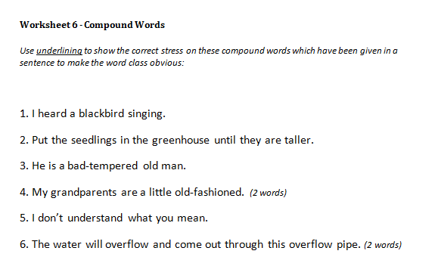
Worksheet 6

Slide 61
Answers – worksheet 6 (1)
1. I heard a blackbird singing.
2. Put the seedlings in the greenhouse until they are taller.
3. He is a bad-tempered old man.
4. My grandparents are a little old-fashioned.

Slide 62
Answers – worksheet 6 (2)
5. I don’t understand what you mean.
6. The water will overflow and come out through this overflow pipe.
7. I need to go to the supermarket before I leave for the airport.
8. He is waiting at the bus-stop on the main highway.

Slide 63
Answers – worksheet 6 (3)
9. He came straight out of the swimming-pool and into the living-room to answer the telephone.
10. This raincoat isn’t waterproof.
11. Traffic-lights are confusing because I’m colour-blind.
12. What’s he like? Well he’s easy-going, and good-looking, very self-confident and always well-dressed.

Slide 64
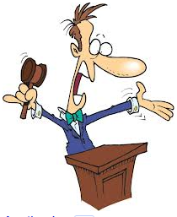
Sentence Auction!
Page 9

Slide 65
Answers!
1 |  | 6
2 | Correct! | 7
3 |  | 8 | Correct!
4 | Correct! | 9 | Correct!
5 | Correct! | 10

Slide 66
Answers!
11 |  | 16
12 | Correct! | 17
13 | Correct! | 18 | Correct!
14 | Correct! | 19 | Correct!
15 | Correct! | 20 | Correct!
88

Slide 67
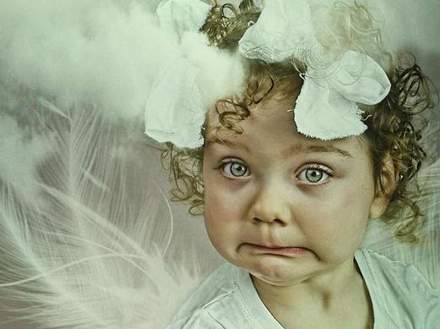
English Pronunciation
Sentence Stress
By Ruth Wickham, Training Fellow, IPGKDRI

Slide 68
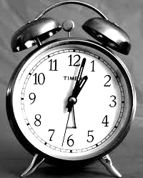
Timing
Syllable Timed
Stress Timed

Slide 69
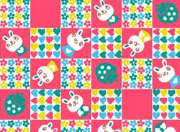
Syllable Timed
Each
syl-
-la-
-ble
takes
the
same
a-
-mount
of
time.

Slide 70
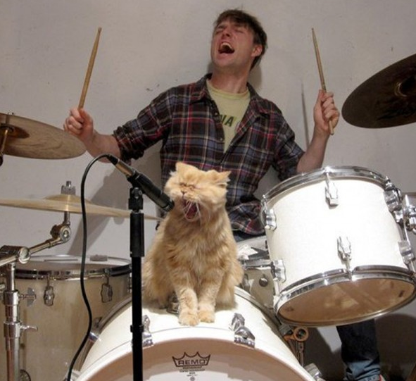
Stress Timed
Stressed syllables keep the BEAT.
Un-stressed syllables are spoken quickly in between.

Slide 71
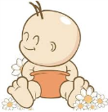
Come on down!
If this is your icon:

Slide 72
Stress-Timed Language
Dogs chase cats
The dogs chase cats
The dogs chase the cats
The dogs will chase the cats
The dogs will be chasing the cats

Slide 73

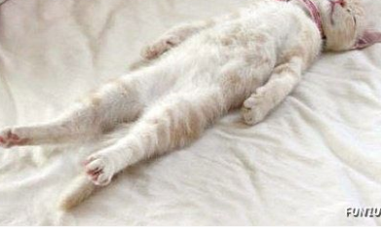
Stress and Unstress ...
‘Stressable’ words
Not ‘Stressable’
Content/Stressed Words
verbs
nouns
adjectives
adverbs
question words
prepositional adverbs
negatives
Function/Unstressed Words
modal auxiliaries
articles
conjunctions
prepositions
pronouns

Slide 74
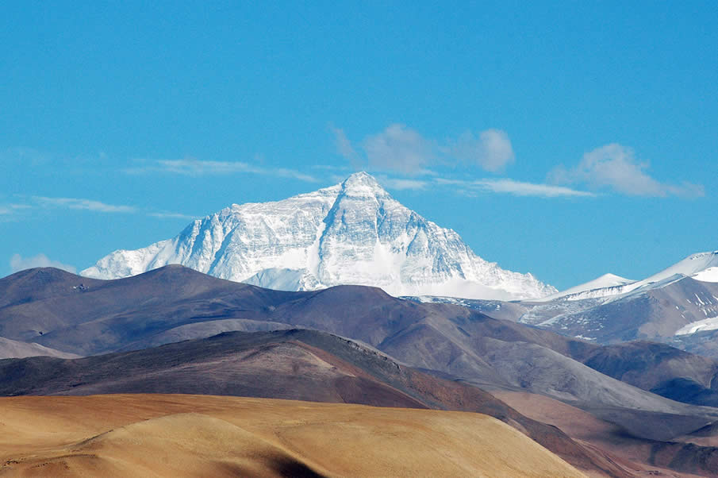
Tonic Syllable
The Tonic Syllable (the peak) is almost always found in a content word in utterance final position.
peak
I'm going.
I'm going to London.
I'm going to London for a holiday.
I'm going to London for HOliday.
Tonic syllable

Slide 75
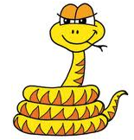
Come on down!
If this is your icon:

Slide 76
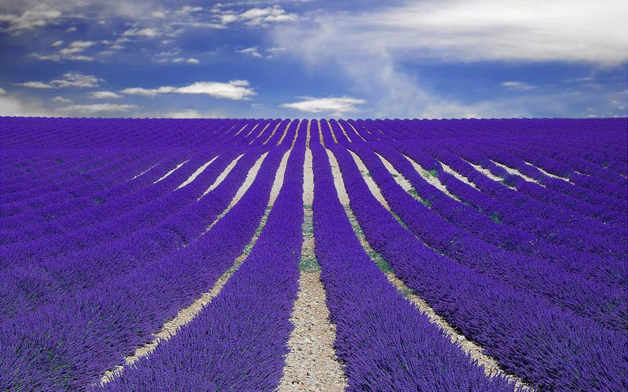
Where is the Tonic Syllable?
Fast automobiles make dangerous friends.
Variety is the spice of life.
Why don't we catch a film tonight?
Janet silently turned the page.
I'll make sure to give him a ring the next time I'm in town.

Slide 77

Emphatic Stress
For emphasis, the tonic syllable moves from its utterance final position .
It usually falls on a modal auxiliary, an intensifier, or an adverb.
It was very BORing.
You mustn’t talk so LOUDly
It was VEry boring.
You MUSTn’t talk so loudly

Slide 78
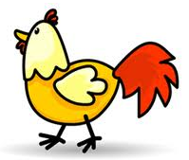
Come on down!
If this is your icon:

Slide 79

Say each of these with Emphatic Stress.
Fast automobiles make dangerous friends.
Variety is the spice of life.
Why don't we catch a film tonight?
Janet silently turned the page.
I'll make sure to give him a ring the next time I'm in town.

Slide 80
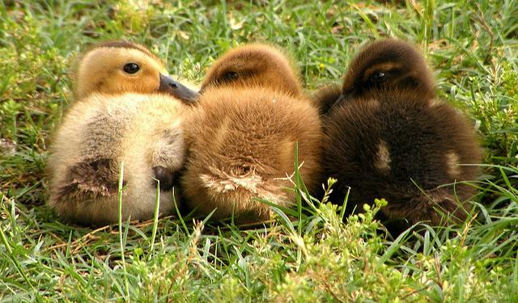
Contrastive Stress
Any word – can be content or function

Slide 81

Come on down!
If this is your icon:

Slide 82

Use contrastive stress on these.
David stole the money, not Mike.
2. David stole the money. He didn't have permission.
3. I haven't seen the film. David has.
4. David stole the money. He didn't touch the jewellery.
5. Mike's birthday is on the twenty-eighth, not the twenty-fourth.

Slide 83

The meaning is in the stress
HAVE you seen my new red car?
Have YOU seen my new red car?
Have you SEEN my new red car?
Have you seen MY new red car?
Have you seen my NEW red car?
Have you seen my new RED car?
Have you seen my new red CAR?

Slide 84

Intonation

Slide 85



Hello!
Hello.
Hello!

Slide 86

Tonal Patterns in English
Four main patterns:
Fall
High - rise
Low - rise
Fall - rise

Slide 87

Fall
time for response
completion
finality

Slide 88
Fall examples:
Punishment and referral:
Requests or orders:
I’ll report you to the poLICE.
Please sit DOWN
I’ve spoken to your PARents.
Call him IN.
‘Wh-’ questions:
Exclamations:
Where is the PENcil?
Watch OUT!

Slide 89
Fall examples (2):
Yes / No question ...
You like it, DON’T you?
if the speaker already knows
the answer,
YES.
or is sure of a ‘yes’ answer.
Have you MET him?
YES

Slide 90

Low – Rise (rising tone)
Yes / No questions when the answer is not known:
A: Isn’t he NICE?
A: Do you want some COFFee?
B: Yes.
B: No.
B: I don’t know.
A: Do you take CREAM in your coffee?

Slide 91

Come on down!
If this is your icon:

Slide 92

High Rise (rising tone)
The Tonic has extra pitch height.
The speaker is asking for repetition, or clarification,
or indicating disbelief.
I’m taking up TAXidermy this autumn.
Did you notice the emphatic stress here?
Taking up WHAT? (clarification)
She passed her DRIving test.
She PASSED? (disbelief)

Slide 93

Fall - Rise
Very often a regional or personal variation:
Sometimes used for checking a list ...
British: Sometimes it can imply that we mean something different from what we are saying:
Yeeesss
I’d like a cake.
(Well, maybe)
(But I probably won’t have one.)

Slide 94

How to write Intonation
∥ \↗ My name is POLLi.∥
∥ \↗I came from RUSSia.∥

Slide 95

Dictation!
To save time, the words are already written for you.
Write down:
1. stress
2. intonation

Slide 96
Symbols to Use
// // tonal unit (listen for pauses)
↘ falling tone
__↗ low rising tone
↗ high rising tone
\↗ fall-rise tone
Underline stressed words
CAPITALS for the tonic syllable

Slide 97

Exam

Slide 98

Only tick ONE box!
√

Slide 99

Come on down!
If this is your icon:

Slide 100
Exam Question 1
Listen carefully …
A
B

Slide 101
Exam Question 2
Listen carefully …
A
B

Slide 102

Come on down!
If this is your icon:

Slide 103
Exam Question 3
Listen carefully …
A
B

Slide 104
Exam Question 4
Listen carefully …
A
B

Slide 105

Come on down!
If this is your icon:

Slide 106
Exam Question 5
Listen carefully …
A
B

Slide 107
Exam Question 6
Listen carefully …
A
B

Slide 108

Come on down!
If this is your icon:

Slide 109
Exam Question 7
Listen carefully …
A
B

Slide 110
Exam Question 8
Listen carefully …
A
B

Slide 111

Come on down!
If this is your icon:

Slide 112
Exam Question 9
Listen carefully …
A
B

Slide 113
Exam Question 10
Listen carefully …
A
B

Slide 114


Evaluation
Please fill in your Workshop Evaluation form.

